Slide 1



Cloud Topics Part I
burt.walsh@ast.myflorida.com
michael.avello@ast.myflorida.com
August 28, 2018

Slide 2

Presentation Overview
Cloud Topics
Code Concepts
Sample .NET Application
S3 and Cloud Storage
Moving the .NET Application to the Cloud
Serverless Computing and Cloud Paradigm

Slide 3
Code Concepts
Threads
Callbacks
Chaining Callbacks
There are other constructs for async

Slide 4
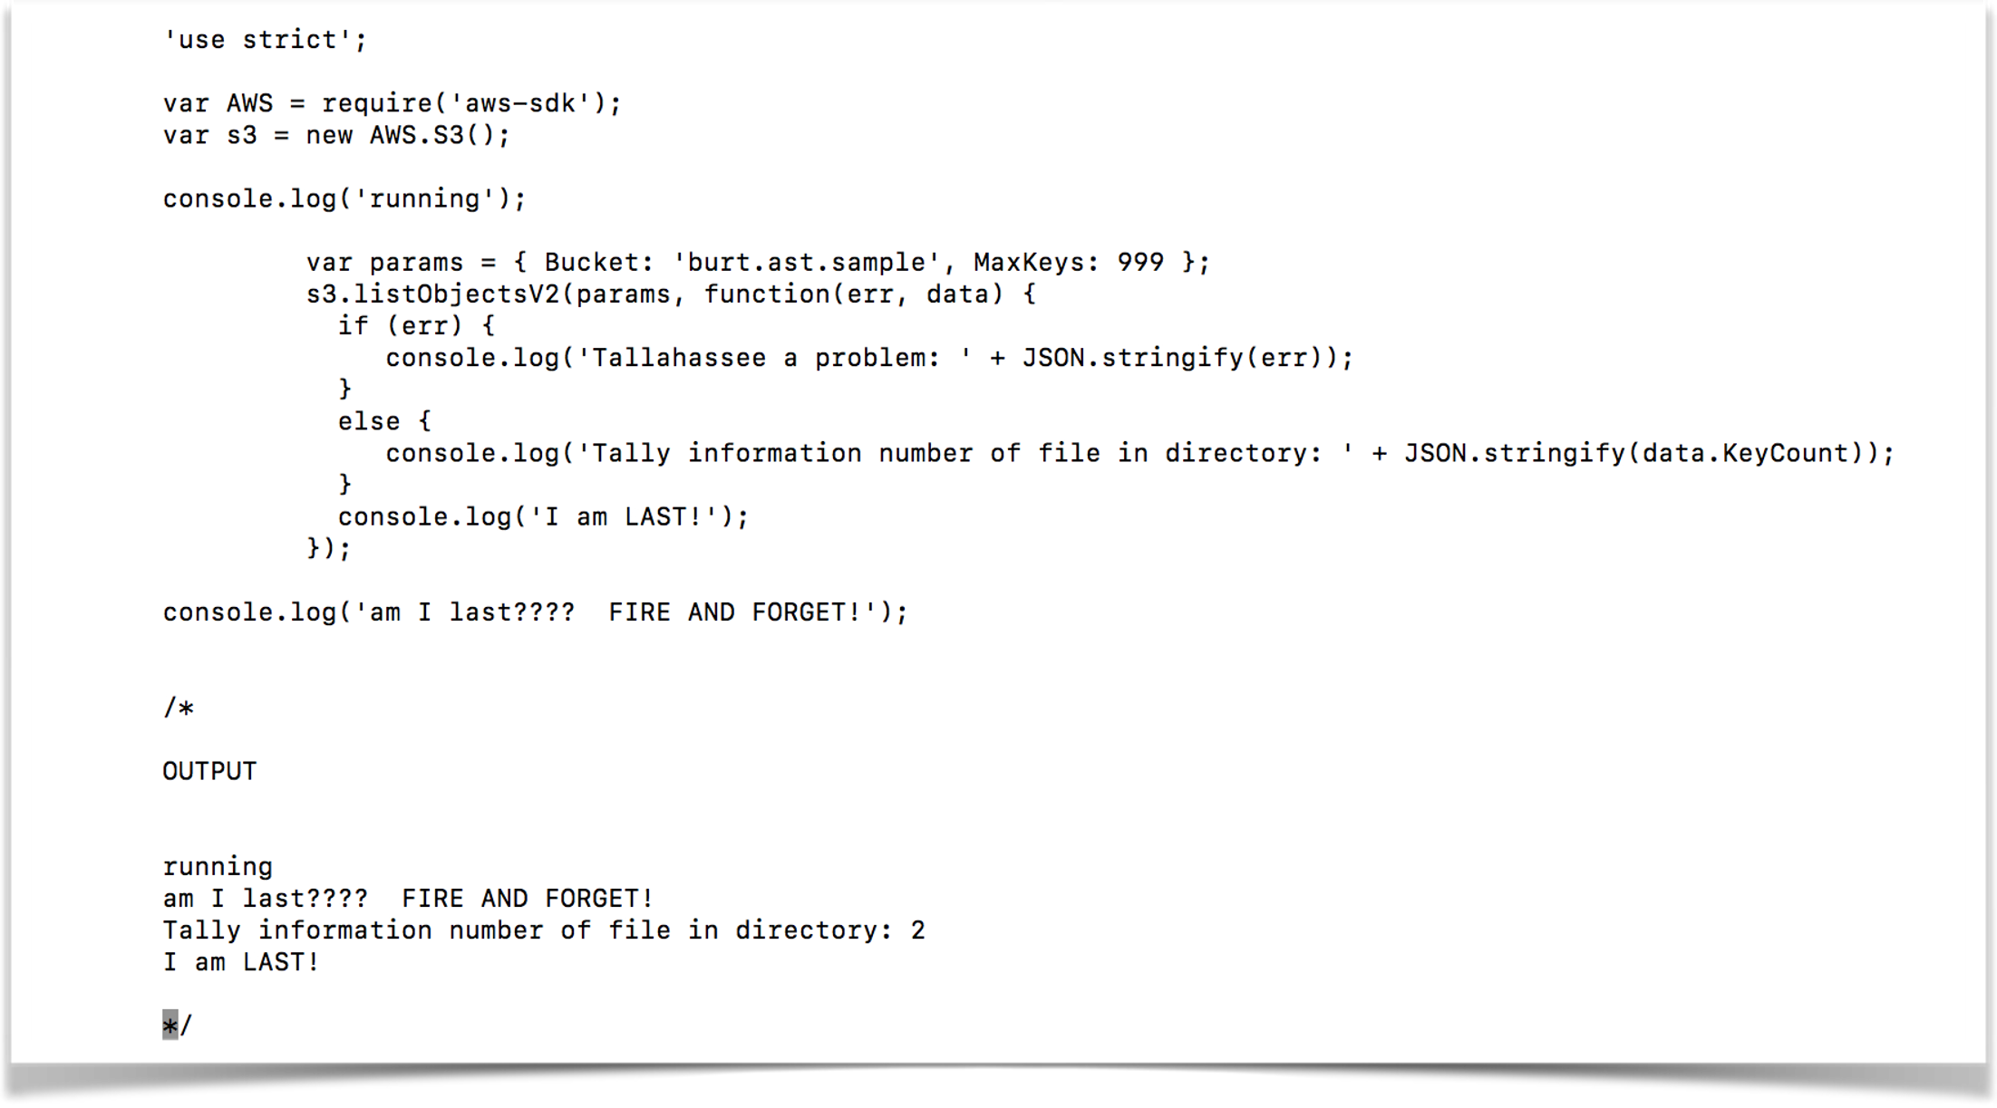
Asynchronous I/O

Slide 5
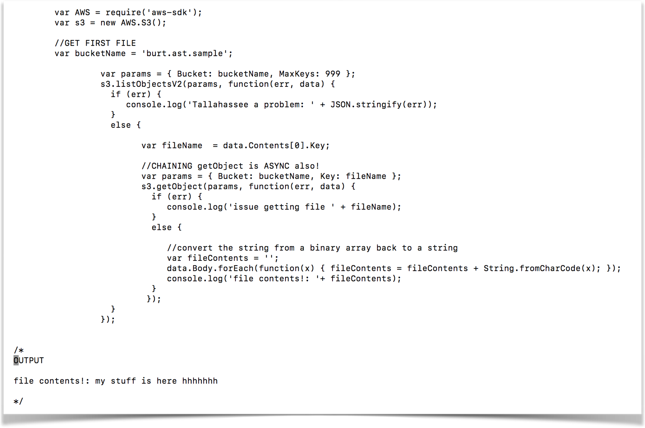
Chaining Callbacks

Slide 6
Sample .NET Application
Upload files
Get word count statistics about files
Web API 2 application
Single Page Application front end

Slide 7
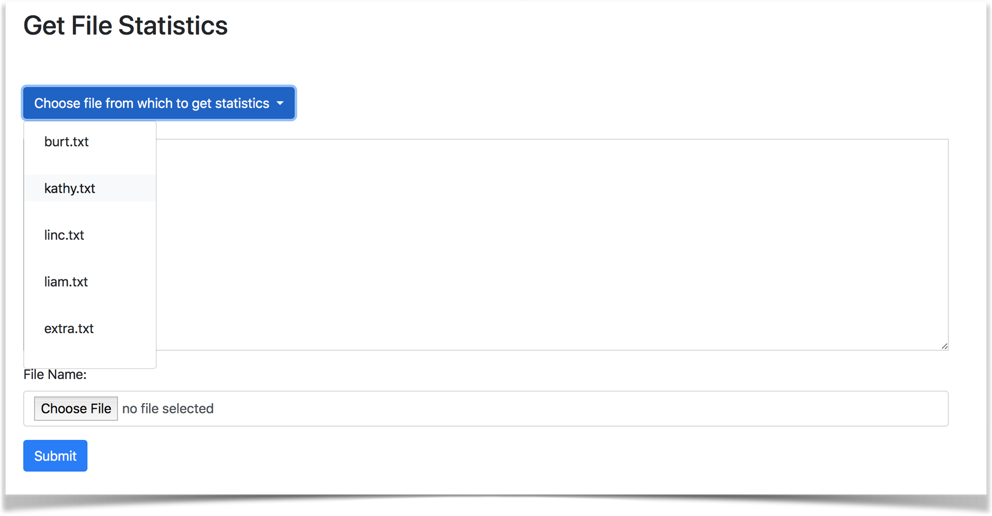
Application Front End

Slide 8
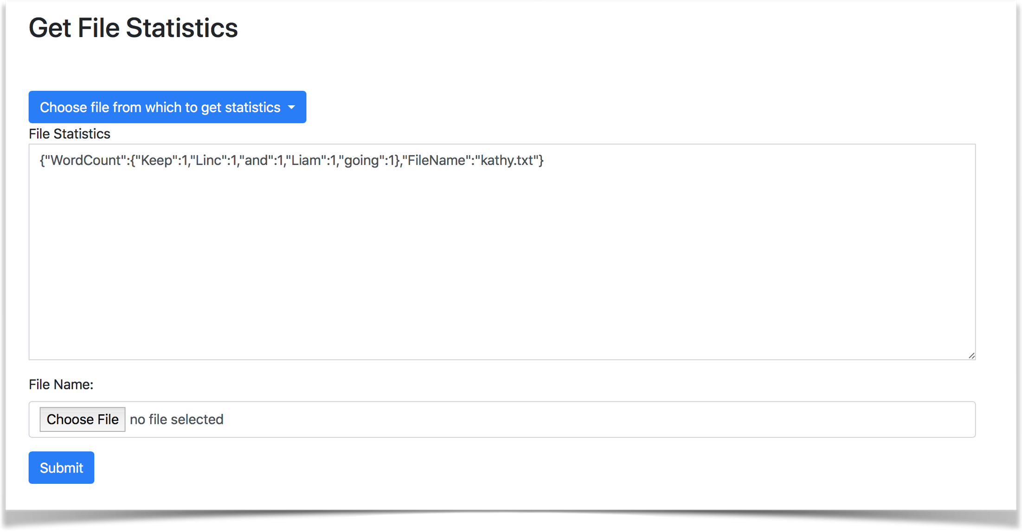
Application Front End

Slide 9
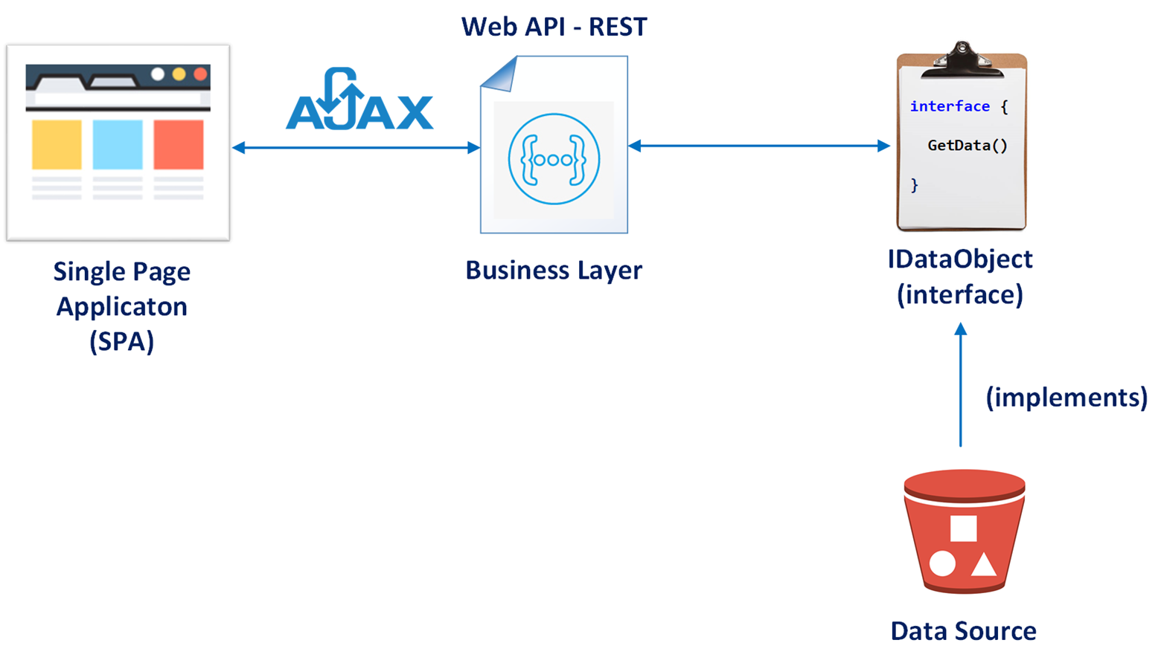
Asynchronous I/O and REST

Slide 10
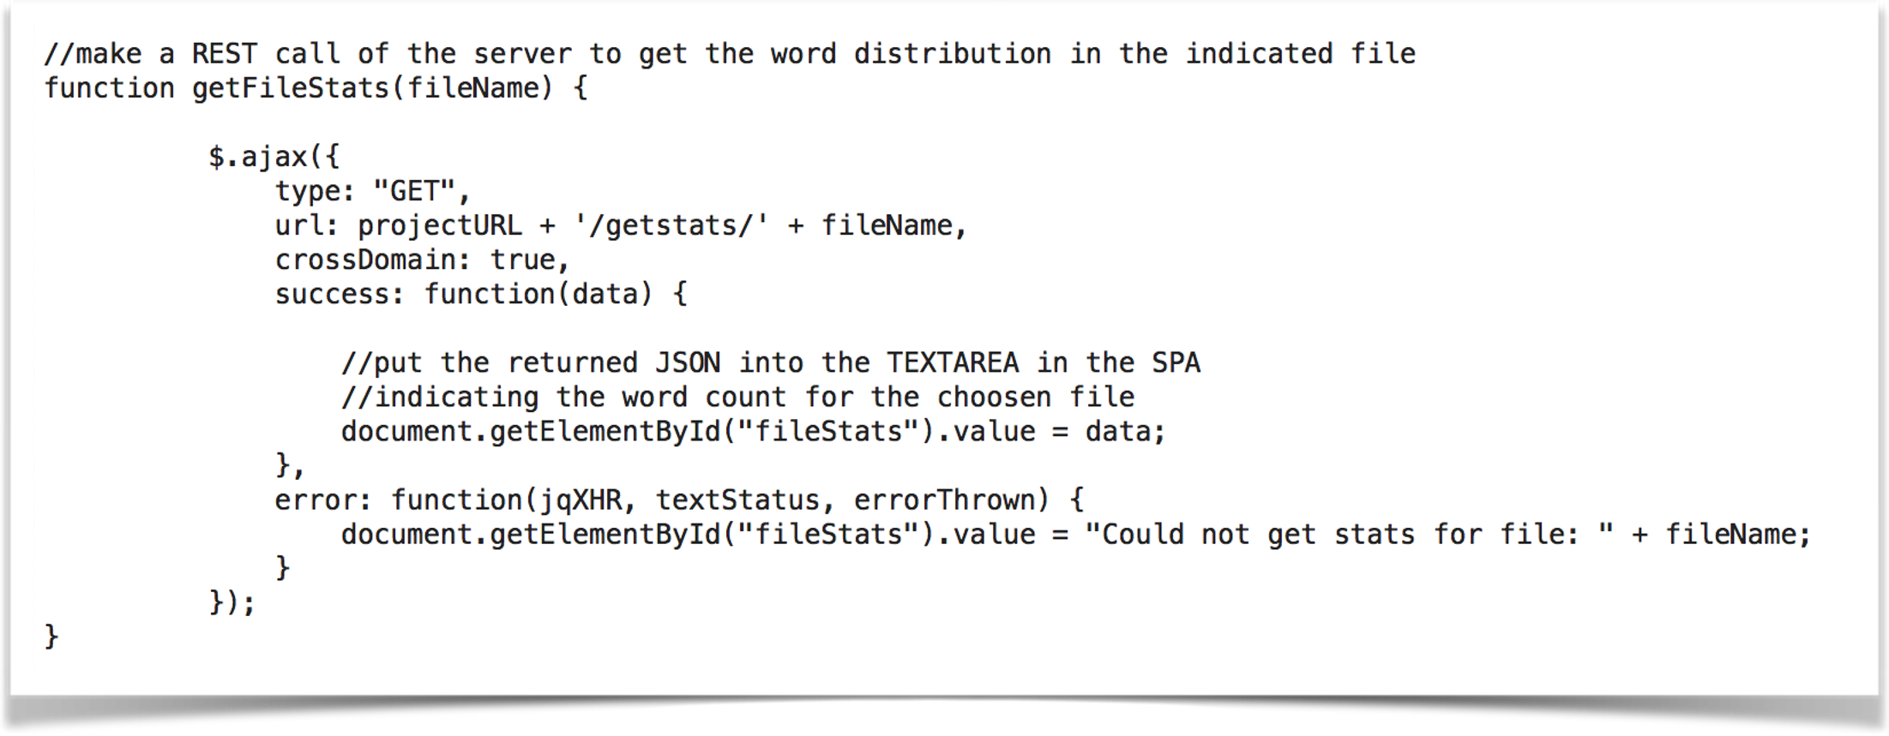
REST Call to C# App
(call from the web page to get stats for selected file)

Slide 11
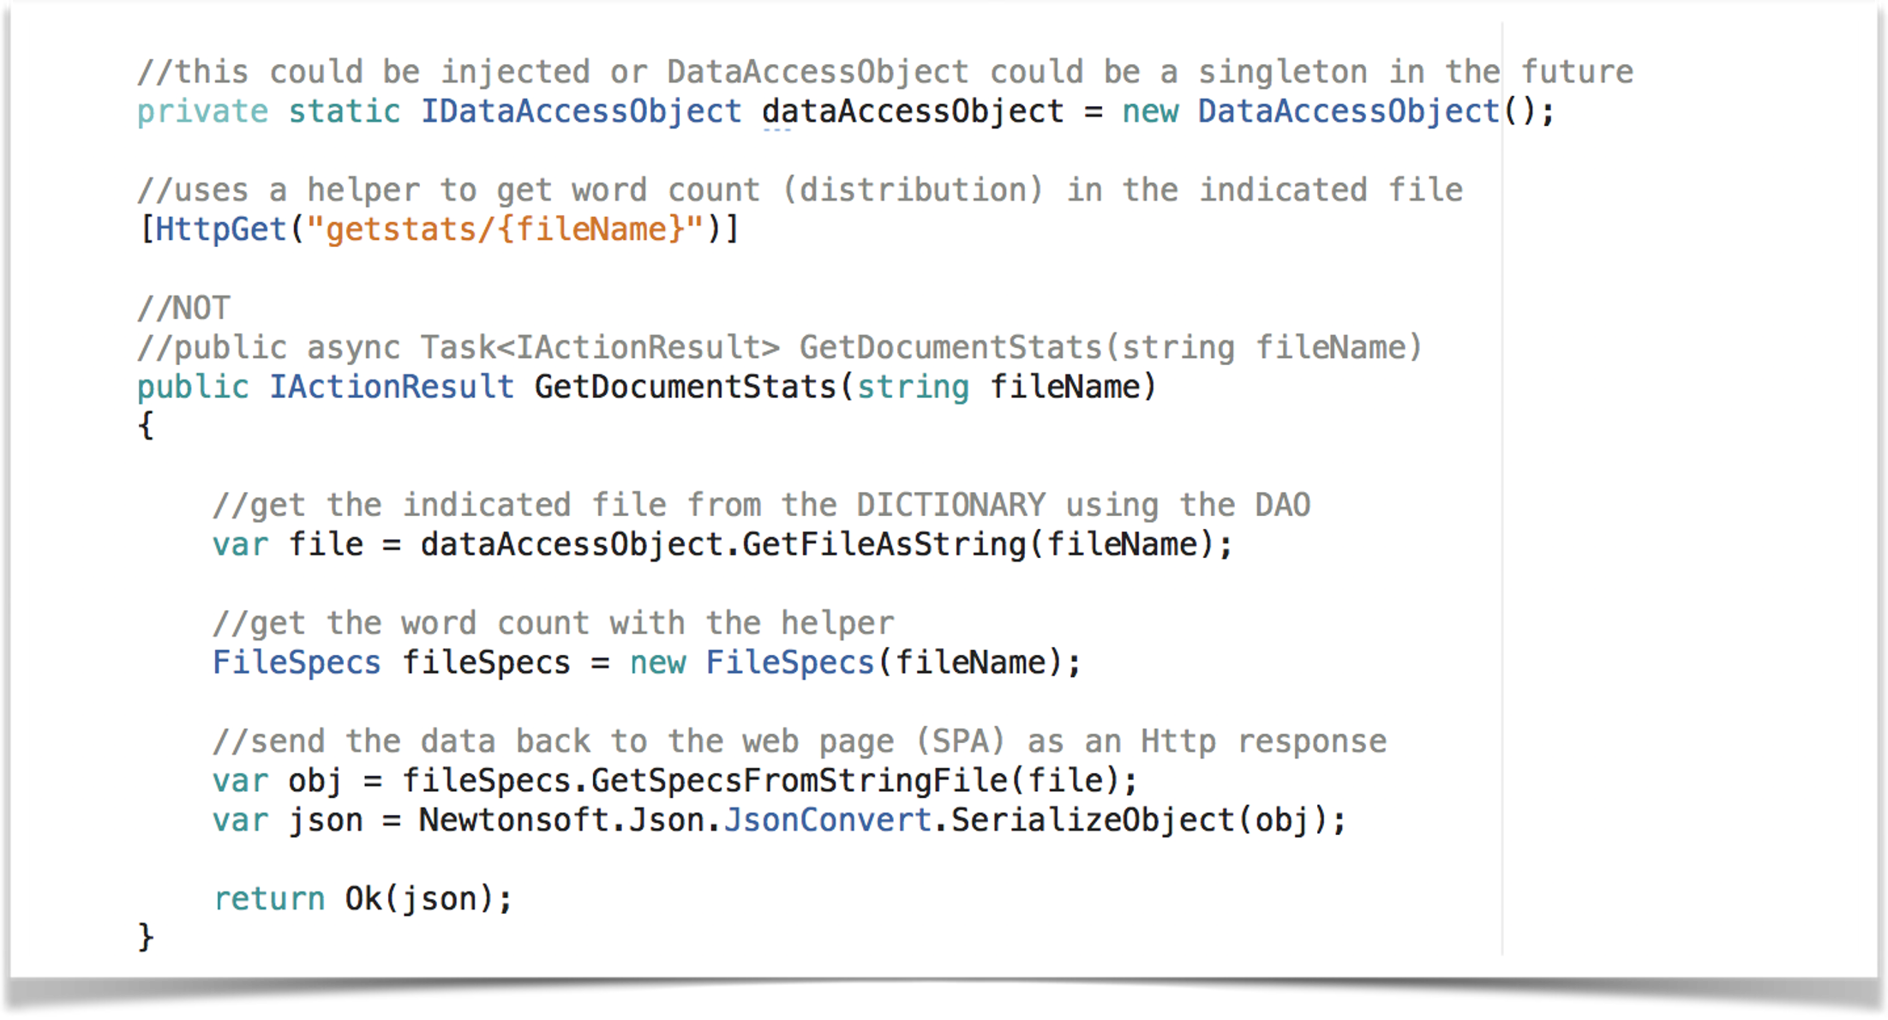
C# REST API Code

Slide 12
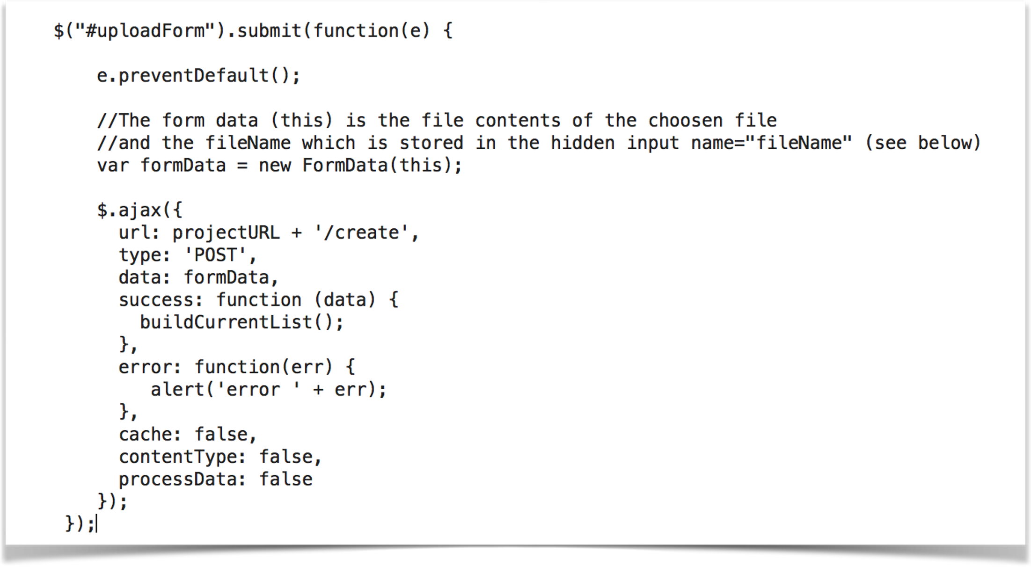
Ajax Uploading a File

Slide 13
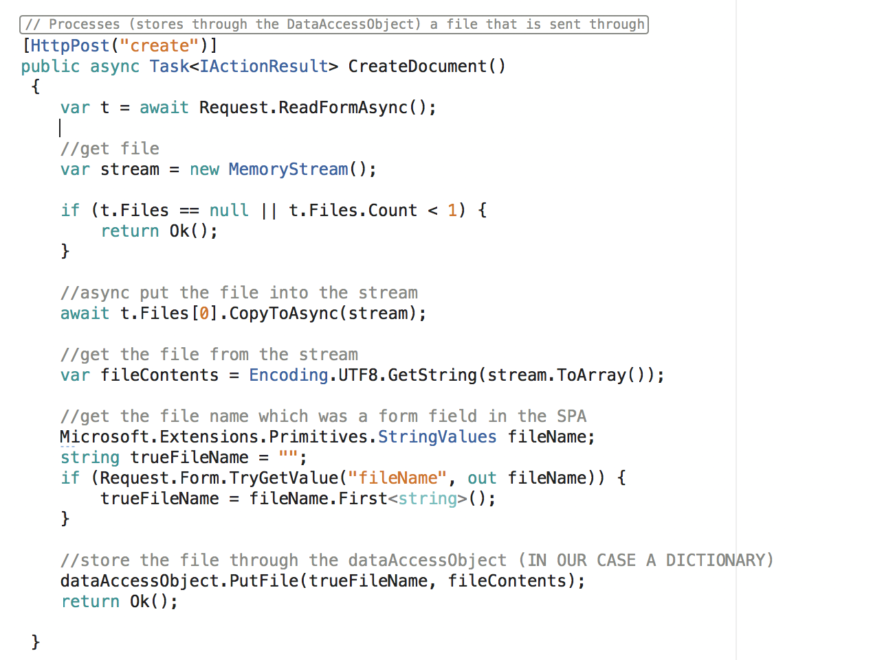
Reading and Storing the File (Async)

Slide 14
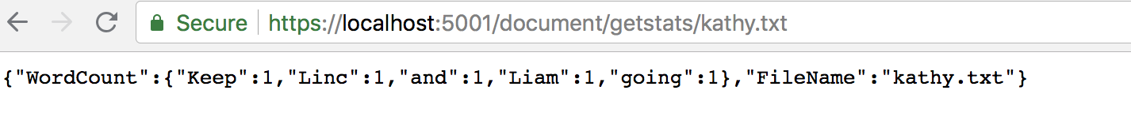
REST Calls are Web Calls

Slide 15
Putting SPA HTML File in an S3 Bucket
S3 is a collection of directories that contain files
It is an AWS file store for files and objects
Notes:
S3 is not block storage for databases, operating systems, etc. – Elastic File System (EFS) is required for block storage.

Slide 16
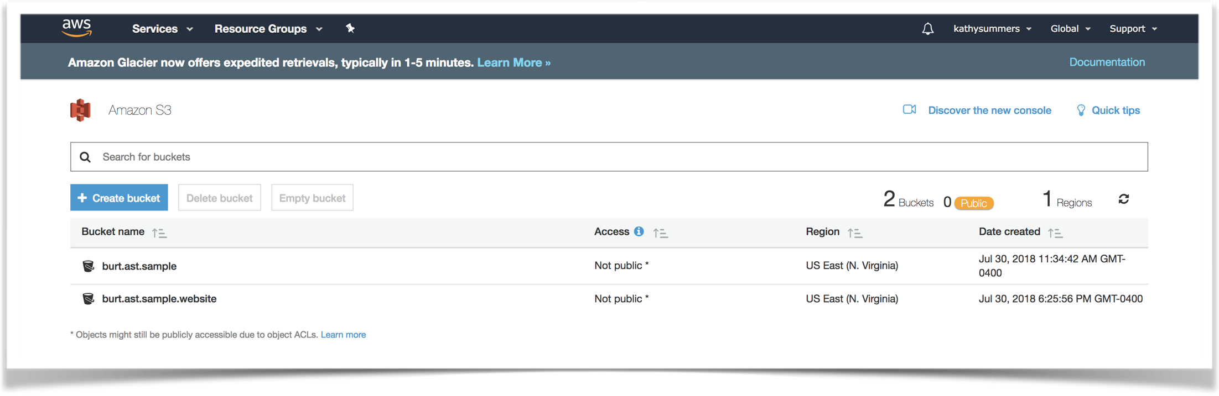
AWS S3 Buckets (Data File/Object Storage)

Slide 17
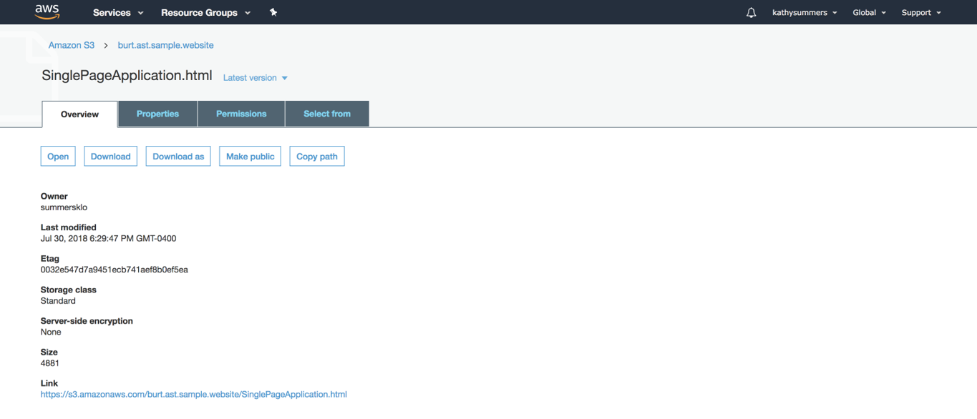
Single Page Application HTML File on S3

Slide 18
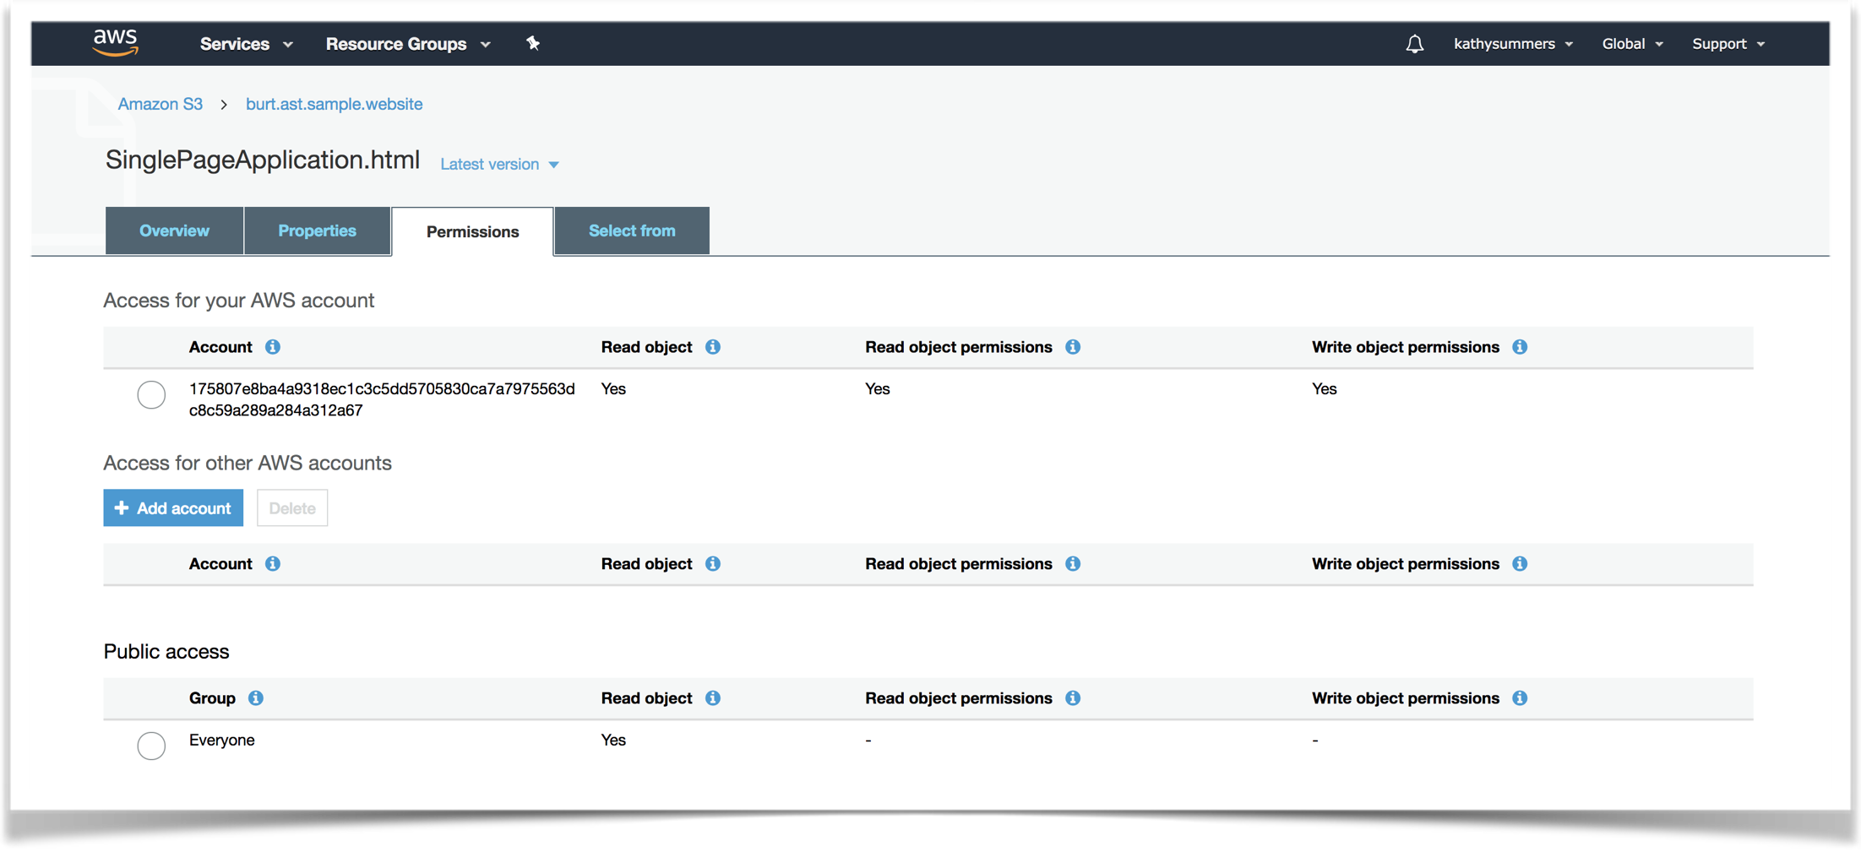
File Permissions on S3

Slide 19
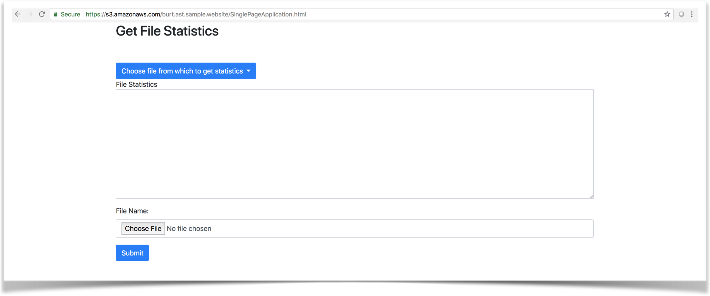
Single Page Application (from S3)

Slide 20
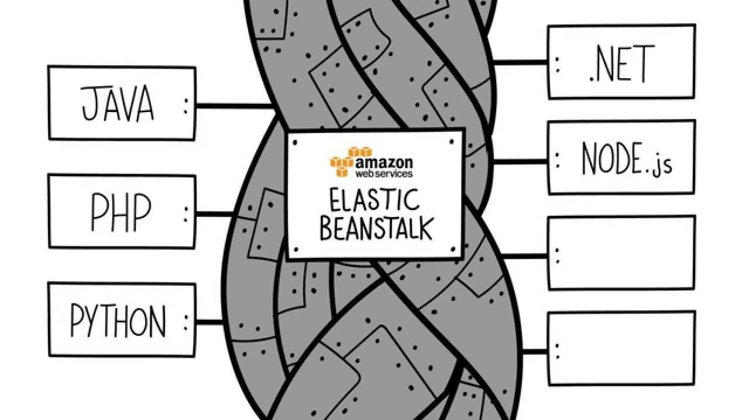
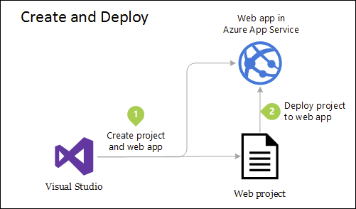
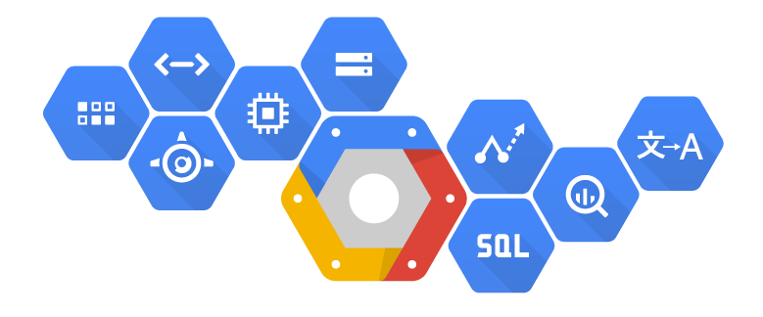
Pushing the App to the Cloud

Slide 21
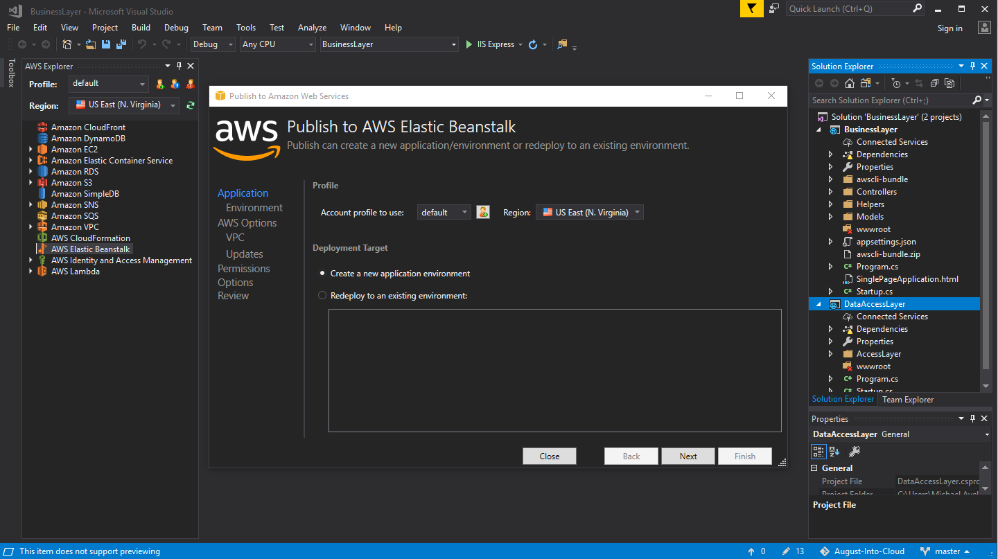
Pushing the App to the Cloud

Slide 22
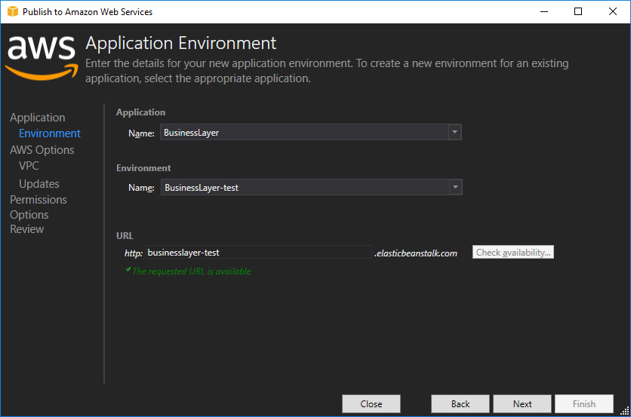
Pushing the App to the Cloud

Slide 23
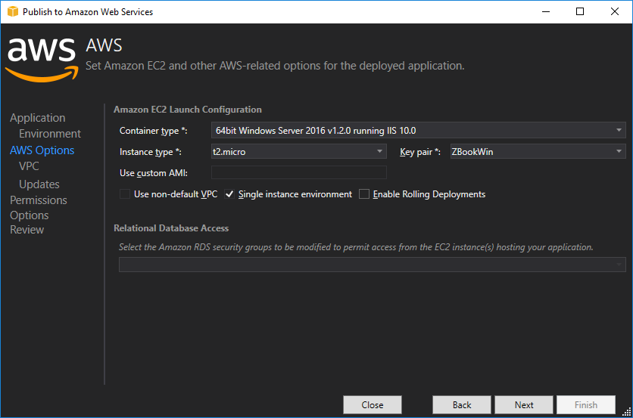
Pushing the App to the Cloud

Slide 24
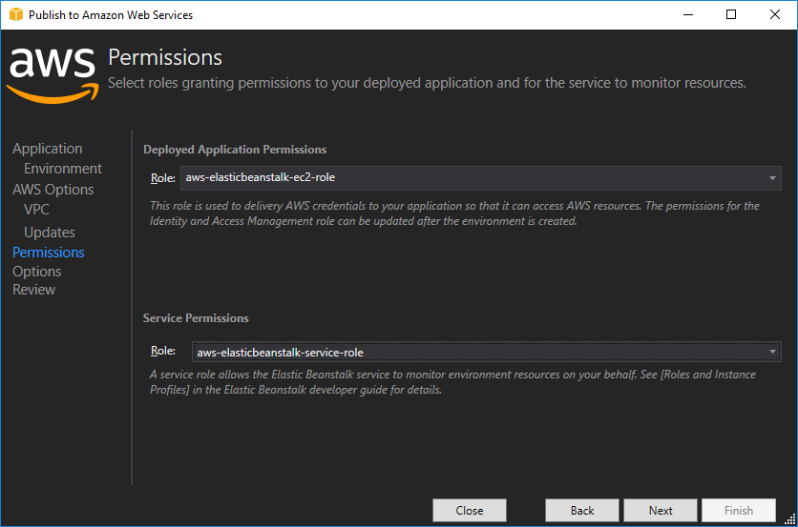
Pushing the App to the Cloud

Slide 25
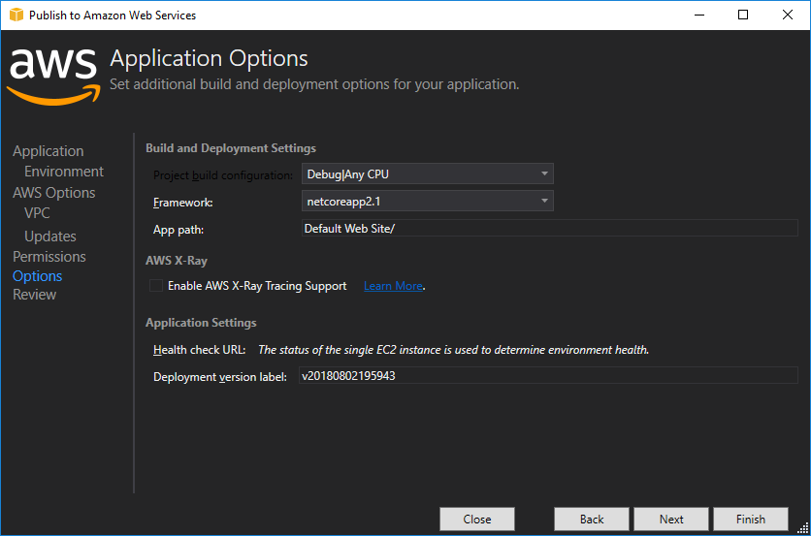
Pushing the App to the Cloud

Slide 26
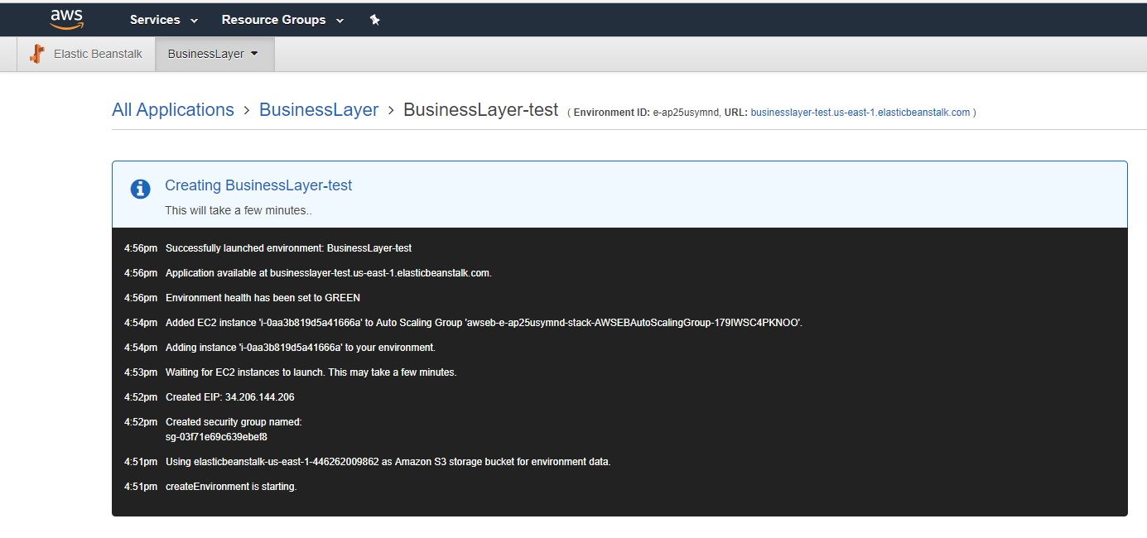
Pushing the App to the Cloud

Slide 27
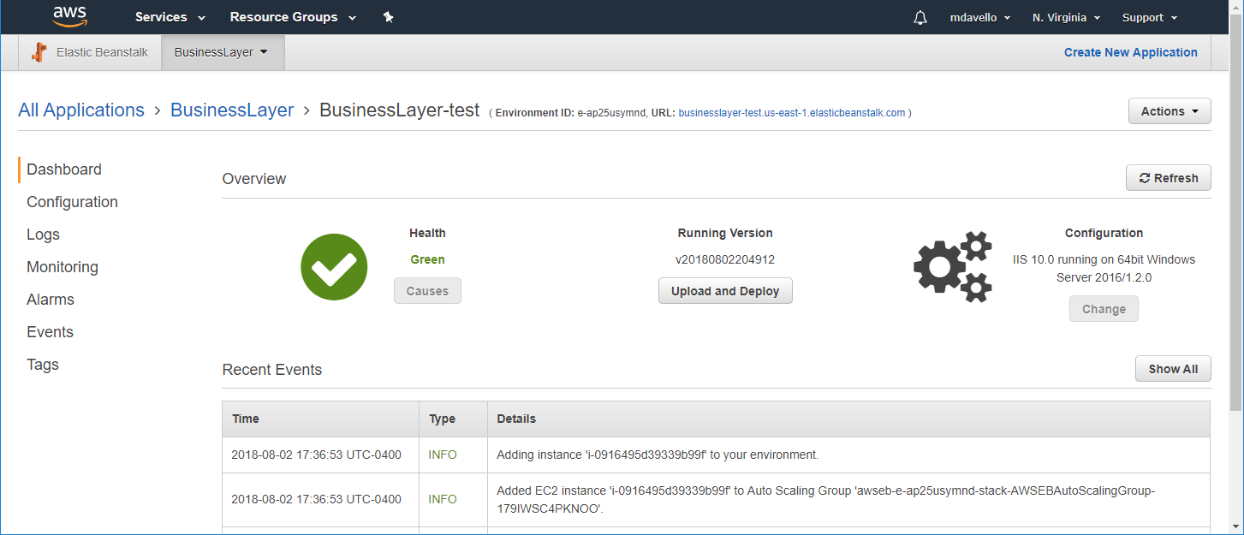
Pushing the App to the Cloud

Slide 28
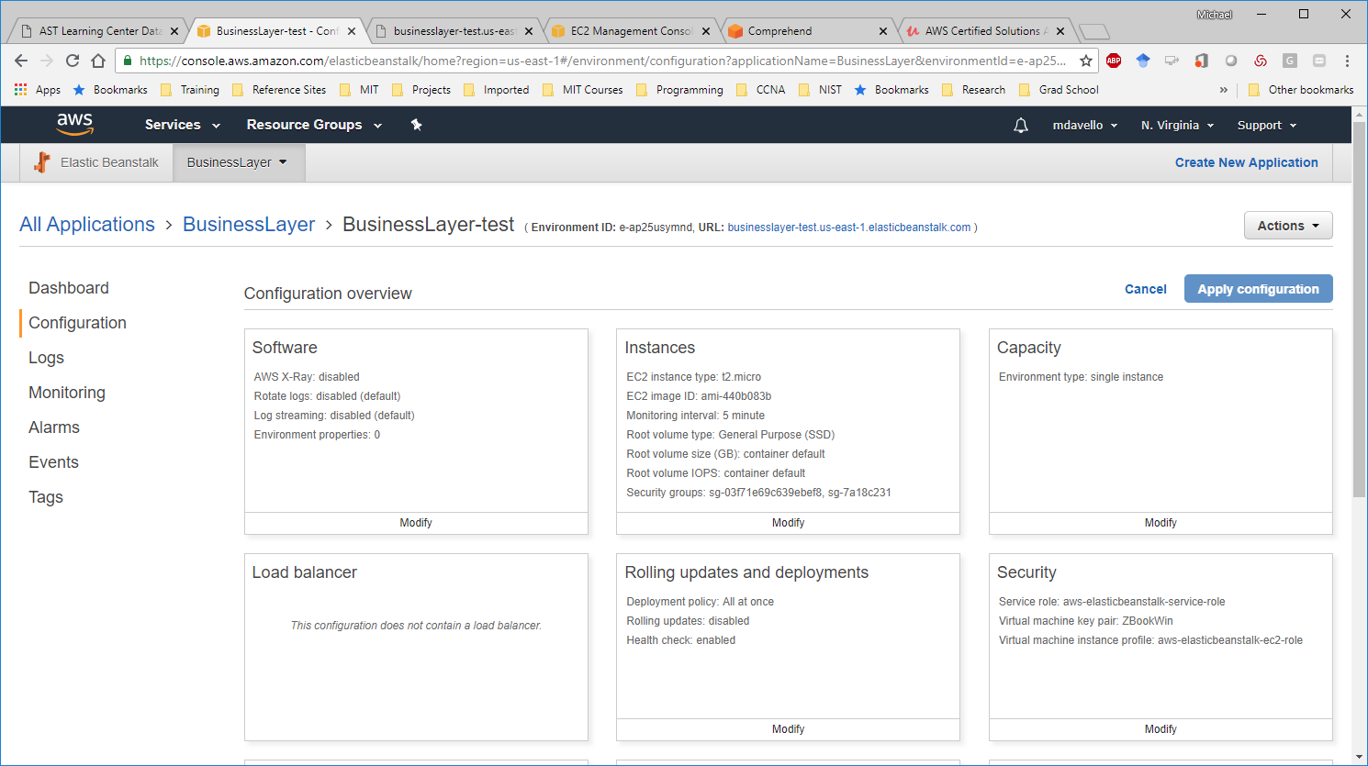
Pushing the App to the Cloud

Slide 29
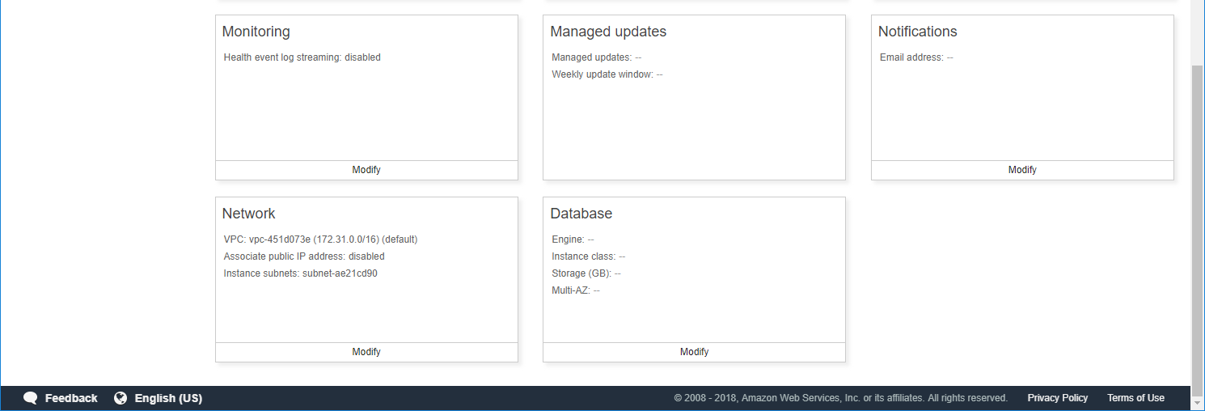
Pushing the App to the Cloud

Slide 30
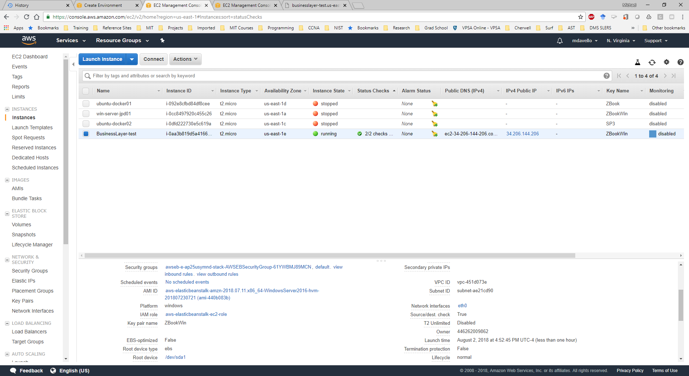
Pushing the App to the Cloud – S3 Instance

Slide 31
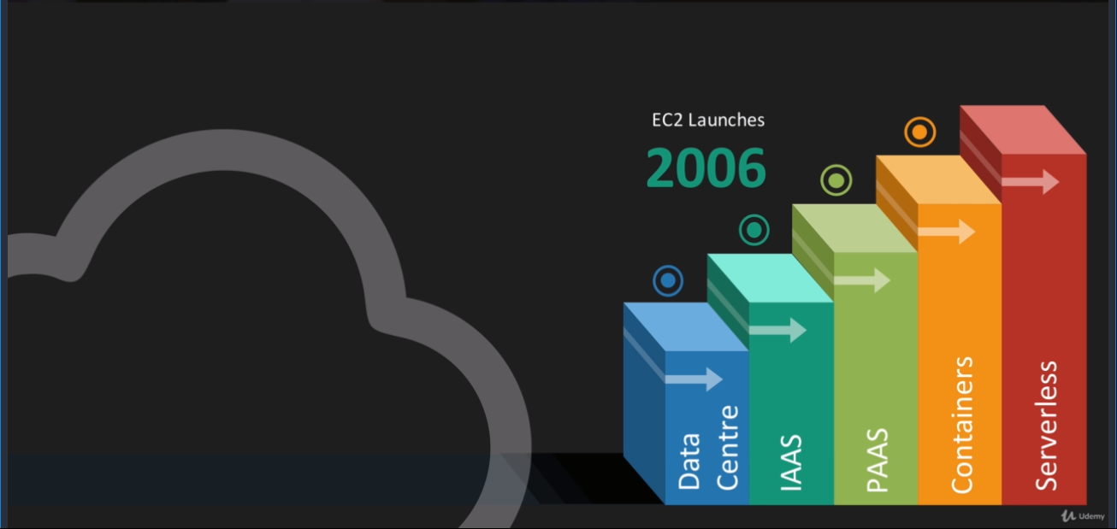
Serverless Computing
Level of Abstraction
Similar to how containers are an abstraction of virtual machines, serverless architecture is an abstraction of container services.

Slide 32
Lambda “Serverless” Functions
The really do run on a server
There are a pool of servers to field the request
You only pay for compute, networking, memory while the Lambda is running
Can leverage libraries

Slide 33
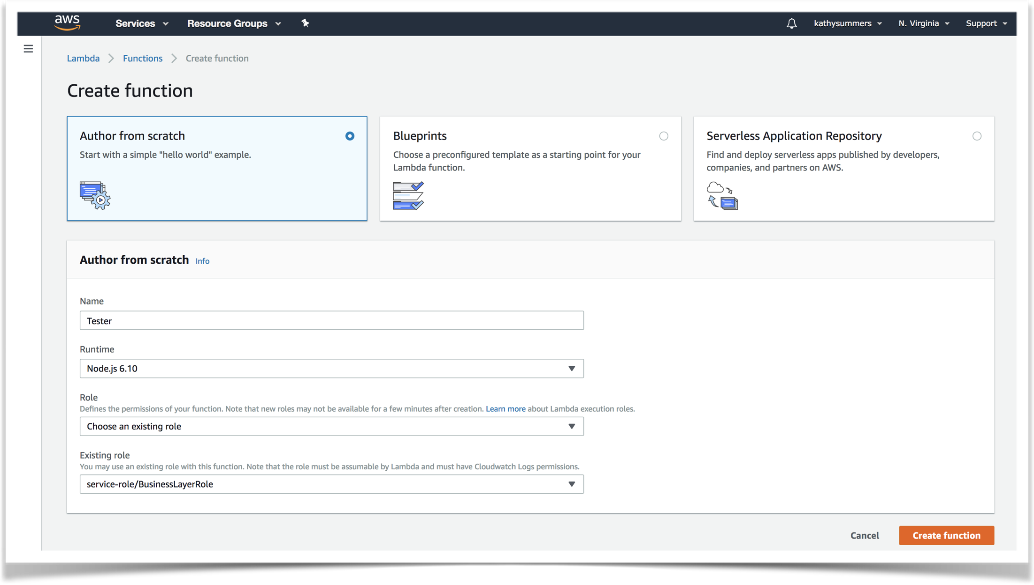
Create the Node.js Function

Slide 34
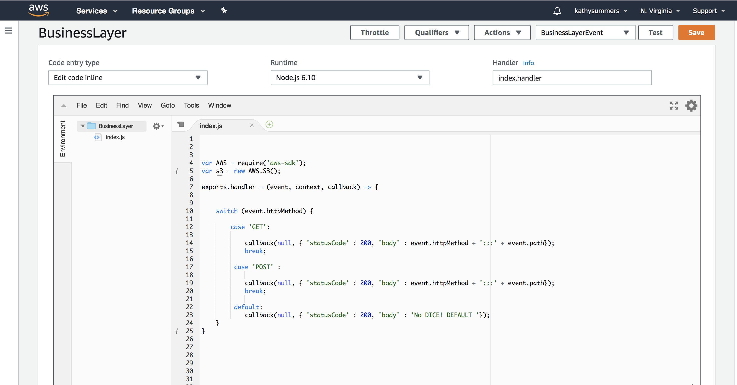

Slide 35
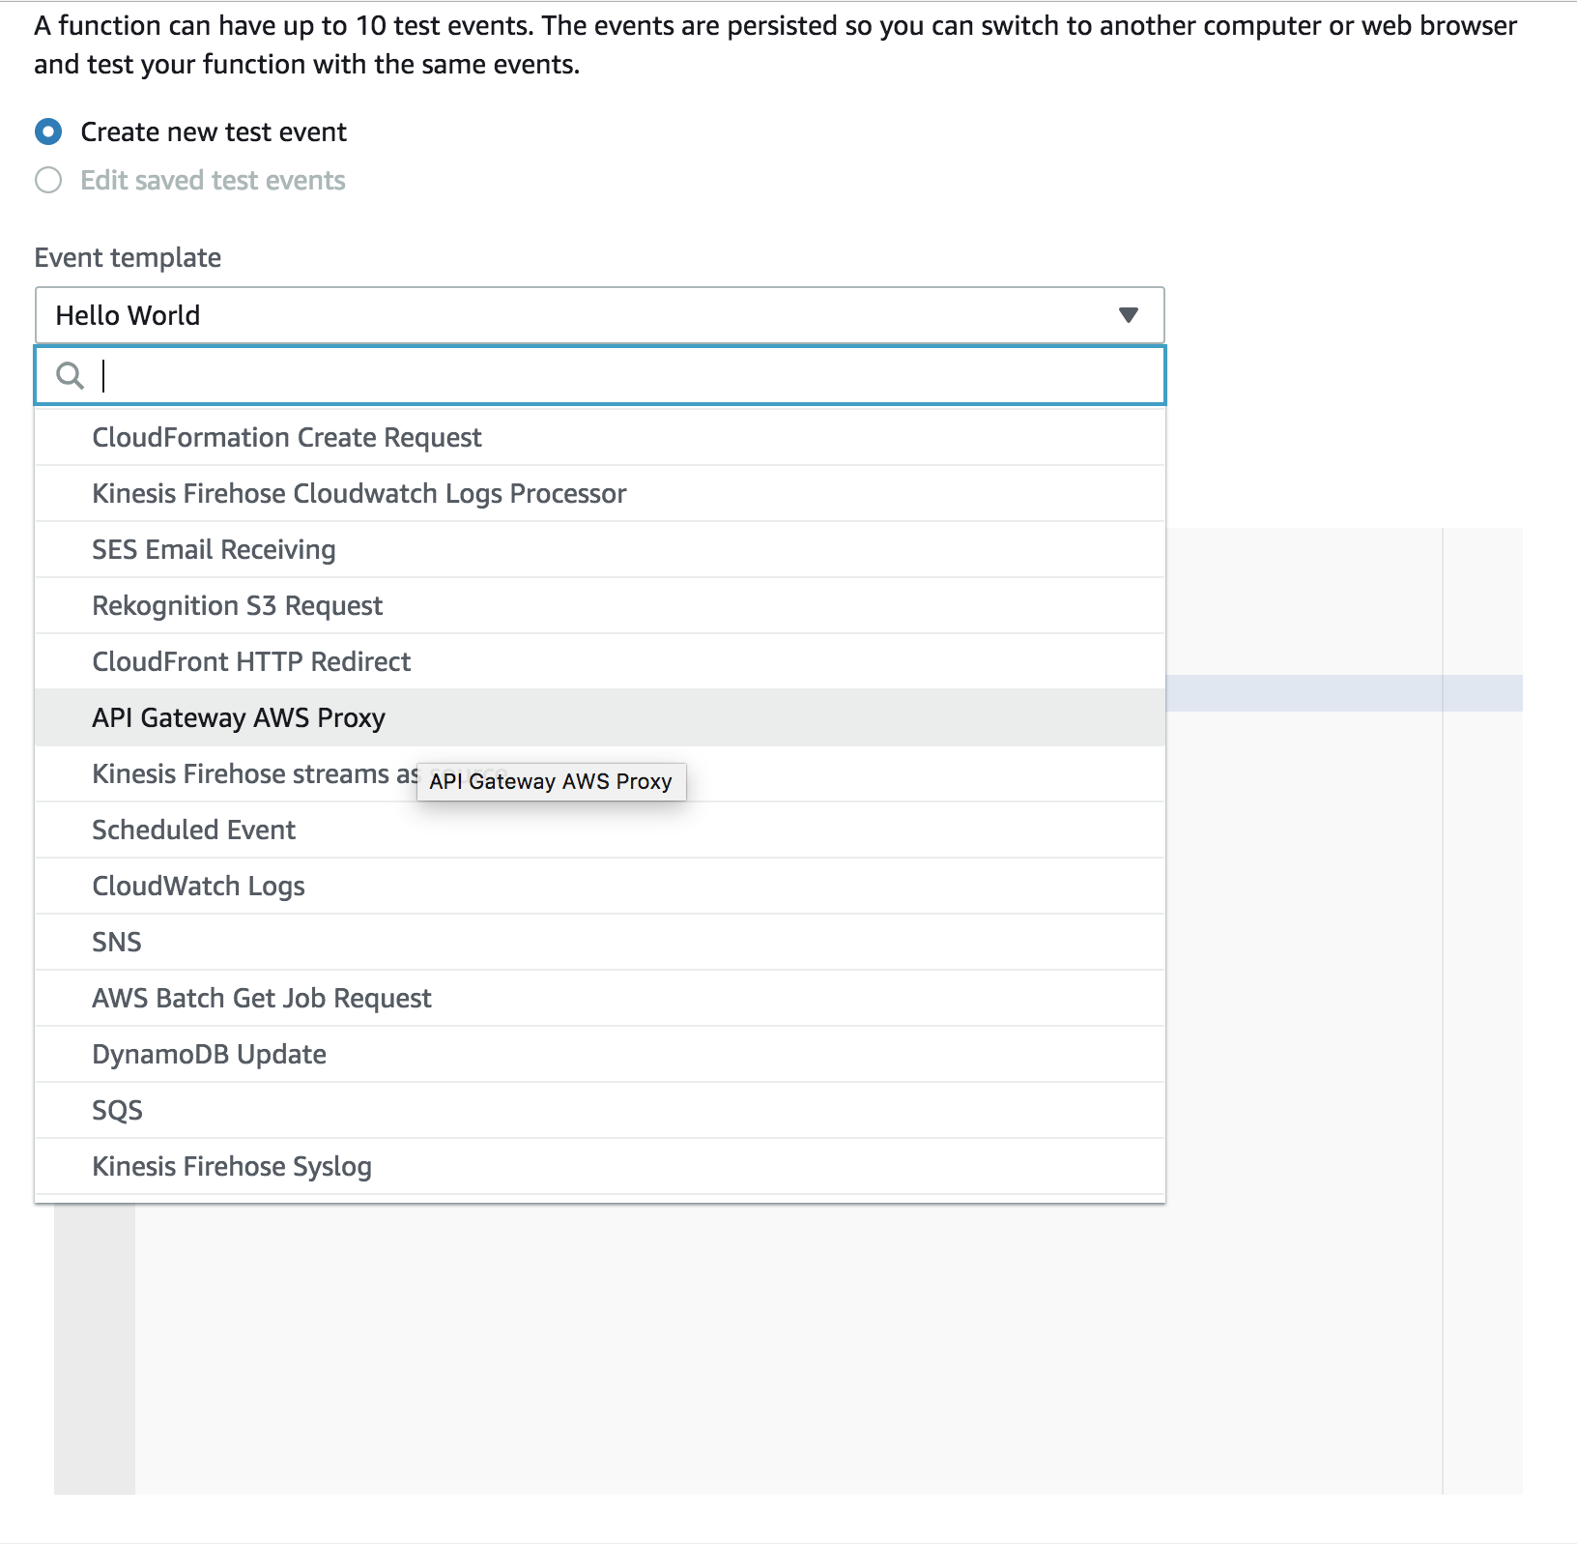
Create Test Event

Slide 36
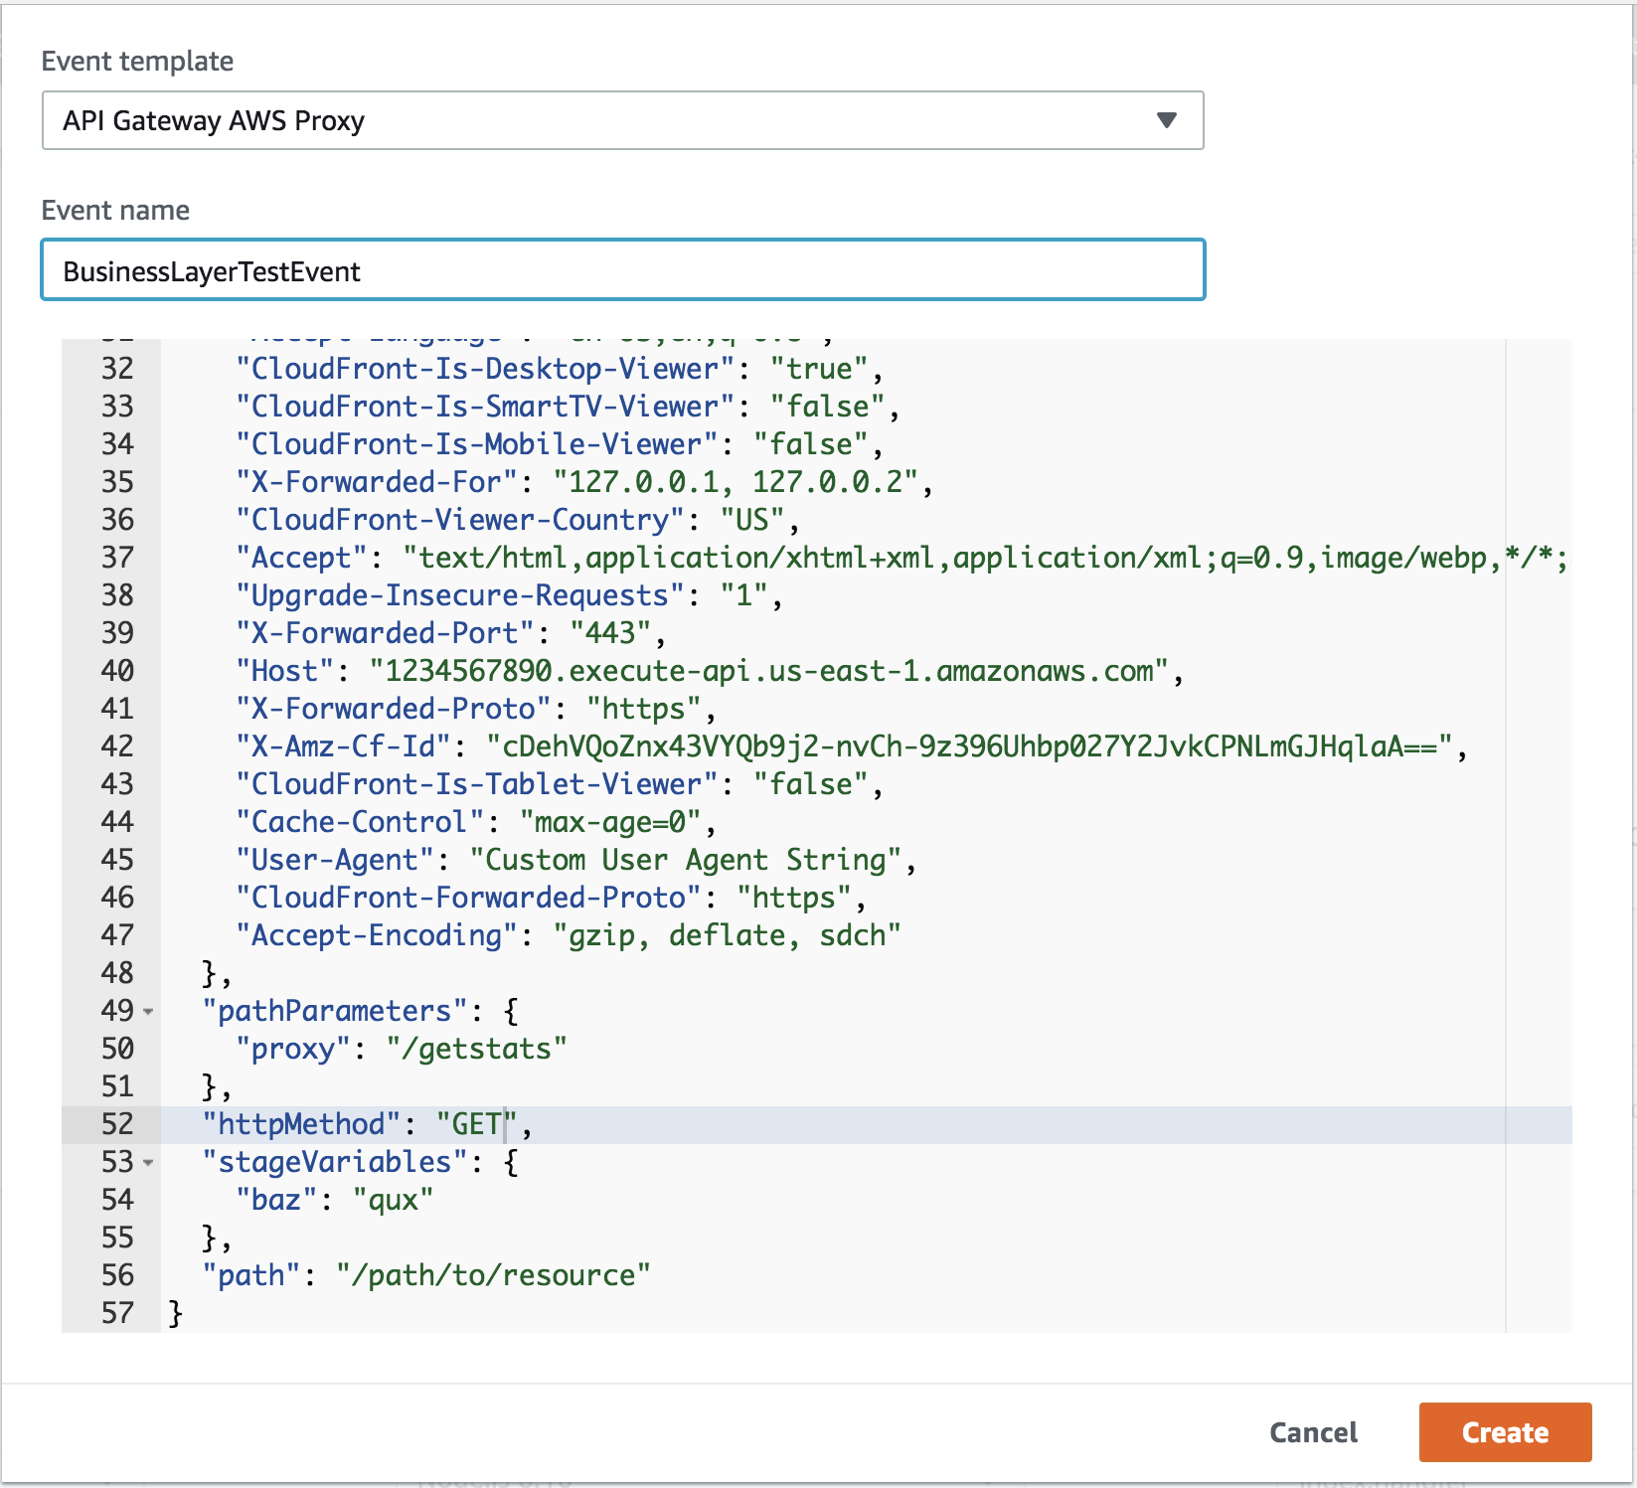
Create Test Event

Slide 37
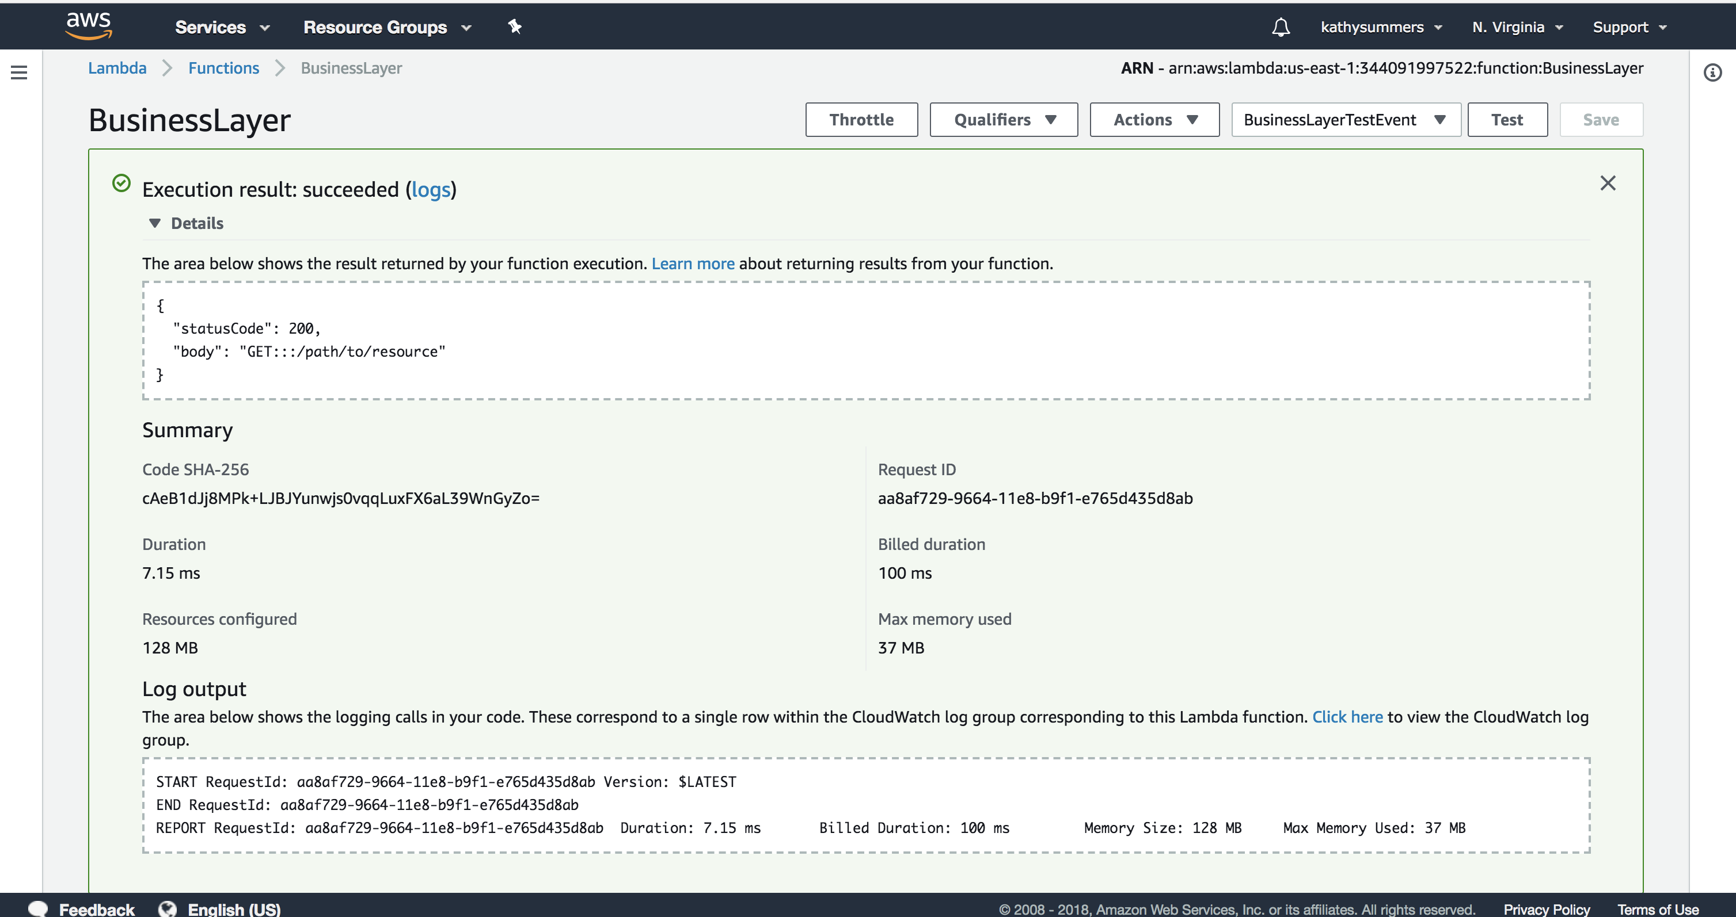

Slide 38
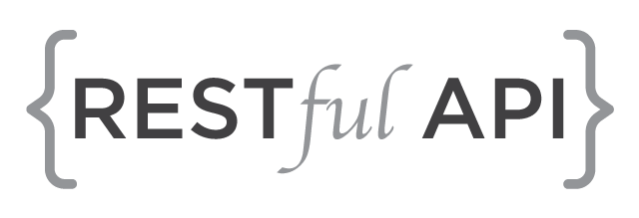
Exposing the REST API

Slide 39
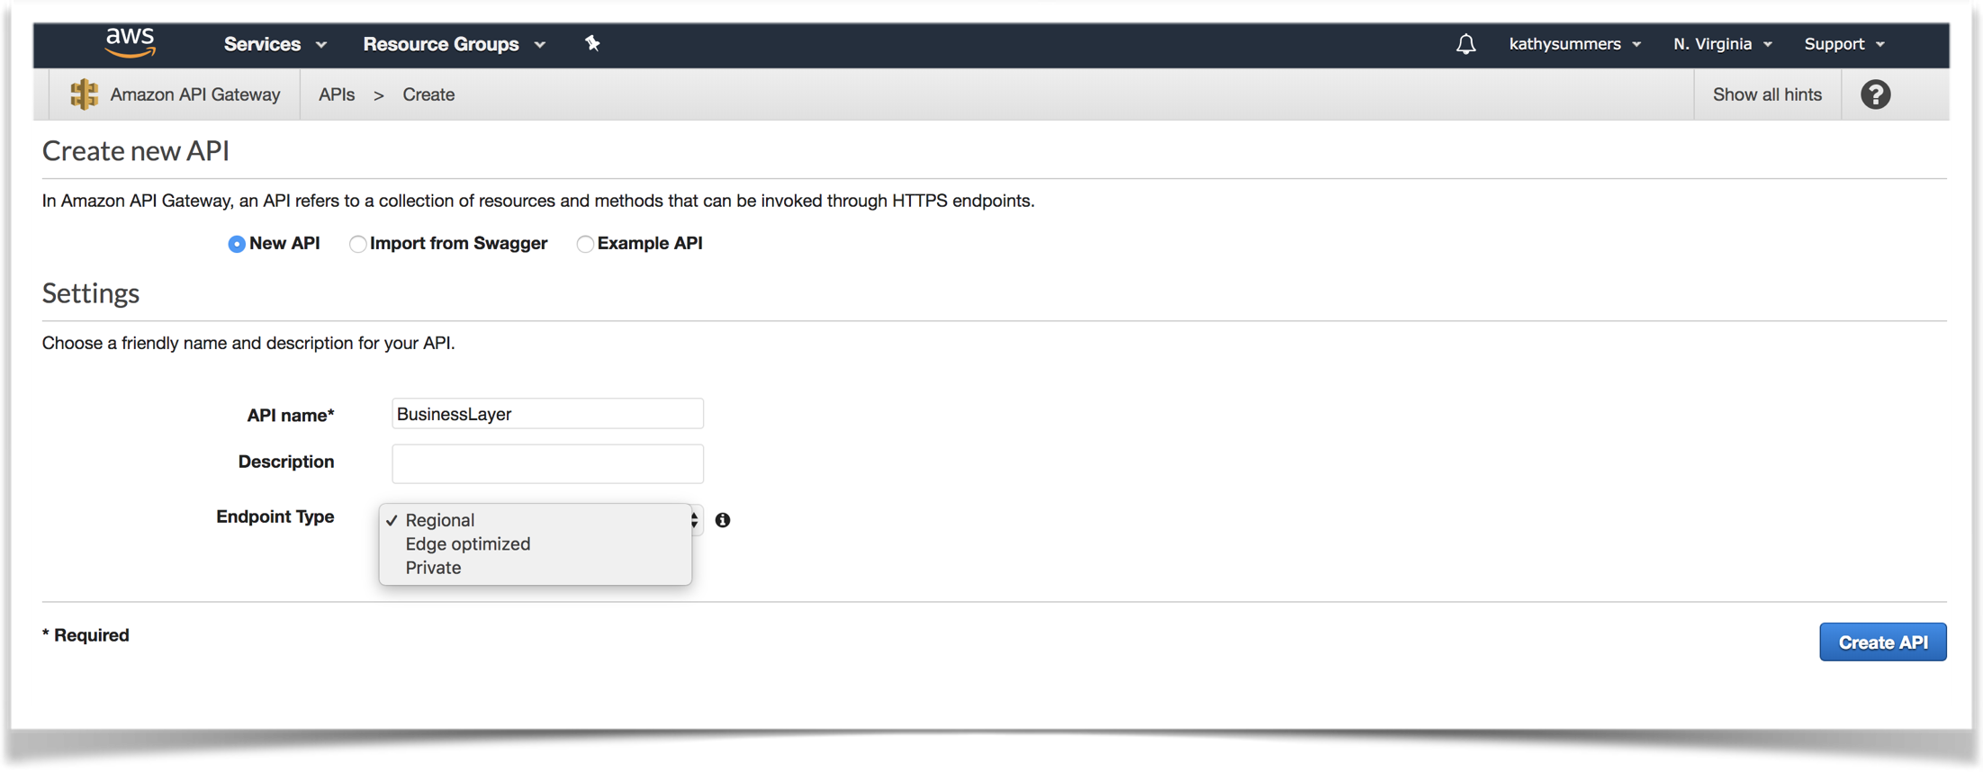
API Gateway

Slide 40
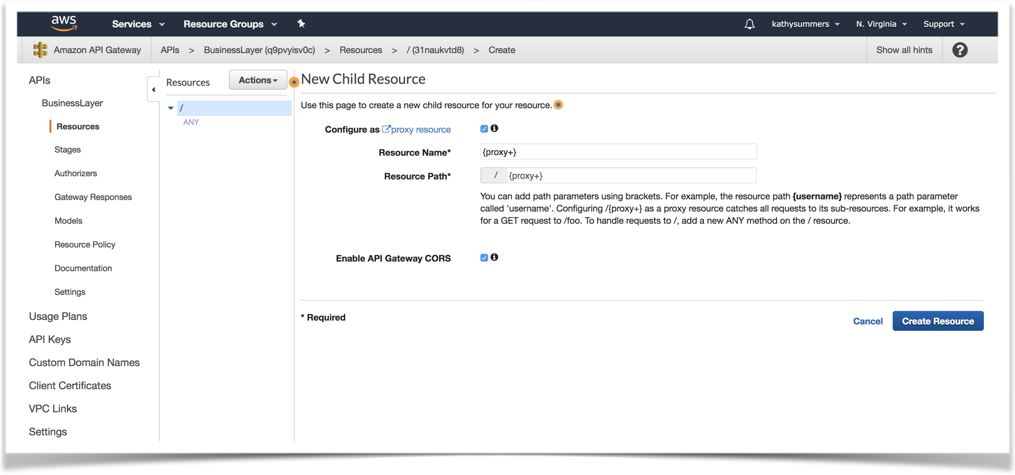
API Proxy Resource Setup

Slide 41
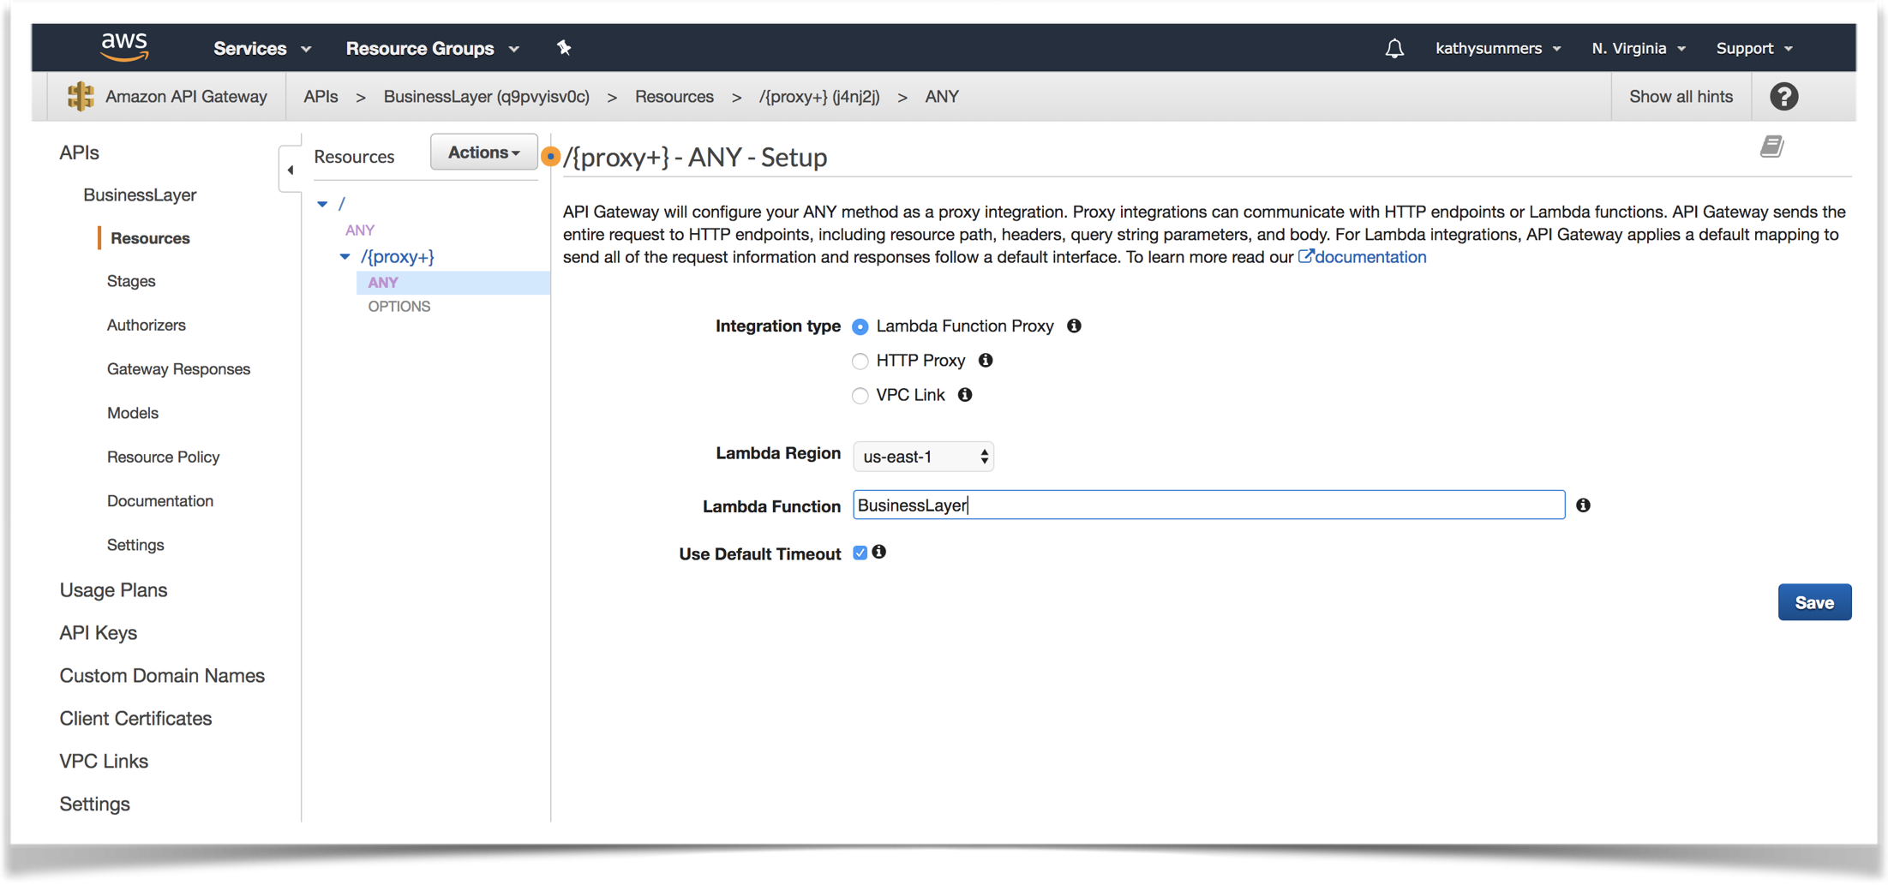
API ANY Proxy Setup

Slide 43
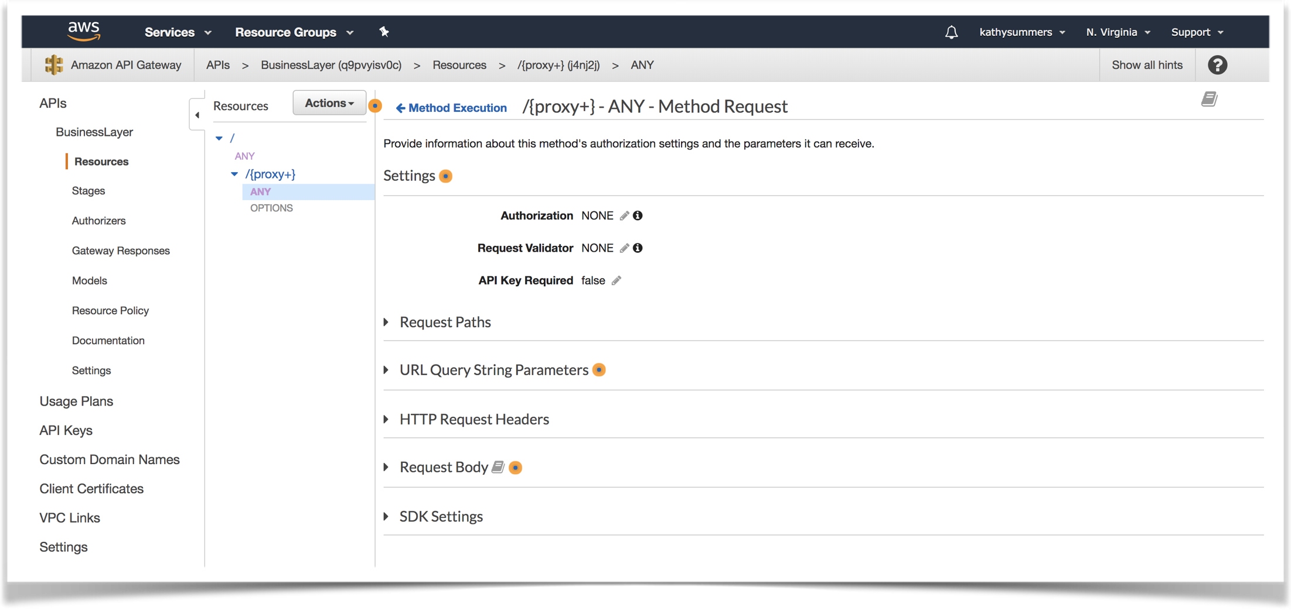
Proxy is Wide Open

Slide 44
Deploying the API
{ … }
GET PUT POST DELETE

Slide 45
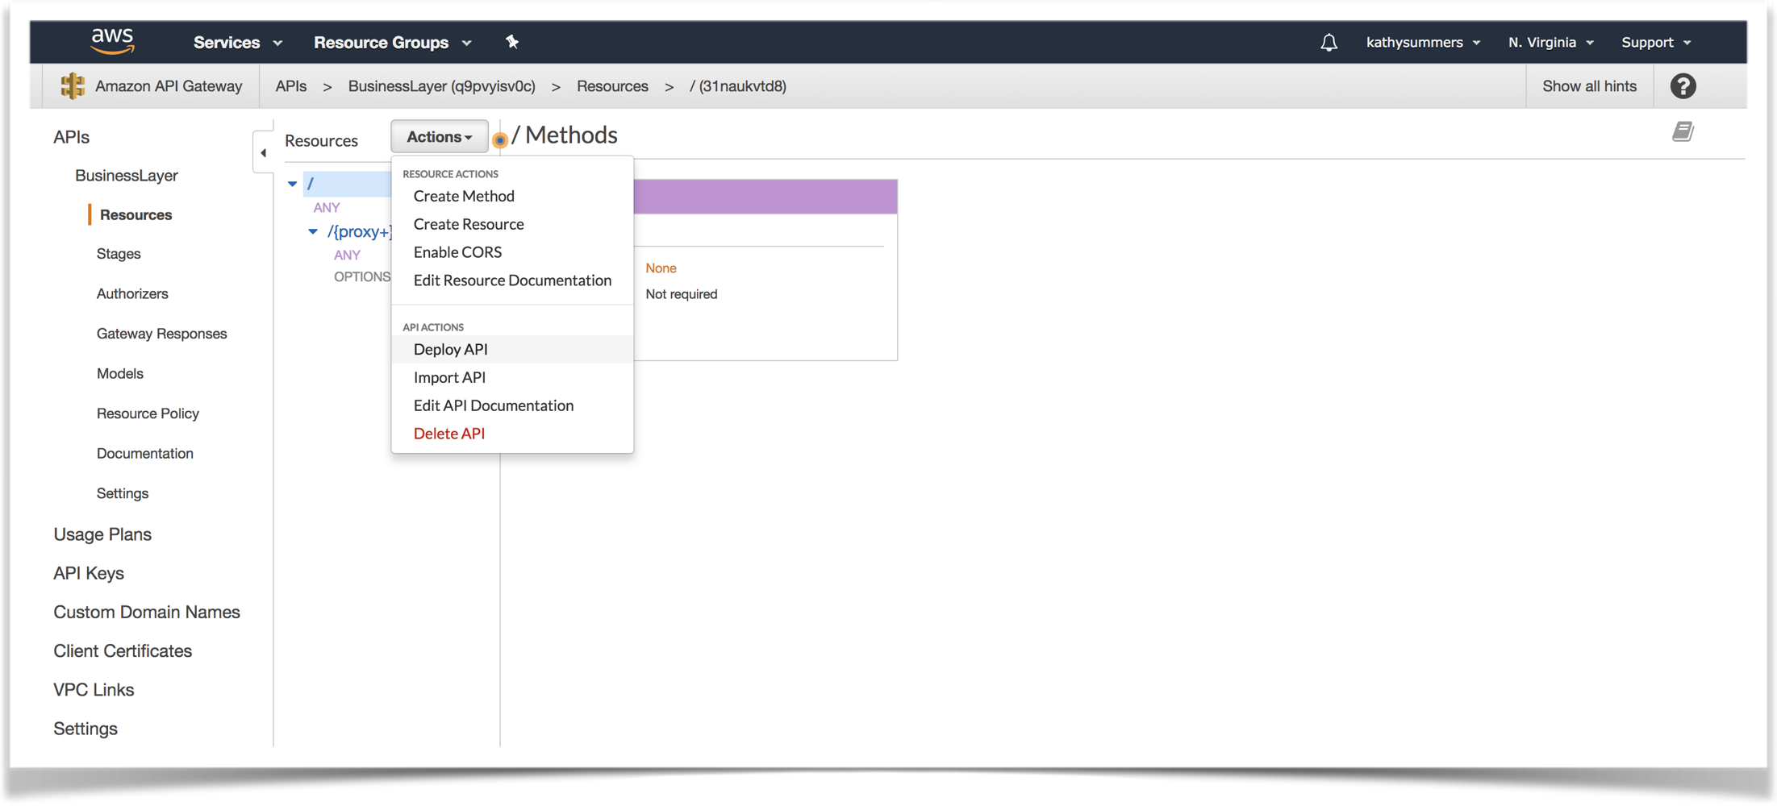
Deploying the API

Slide 46
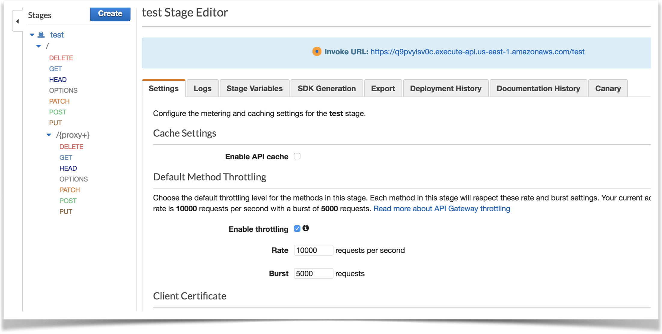

Slide 47
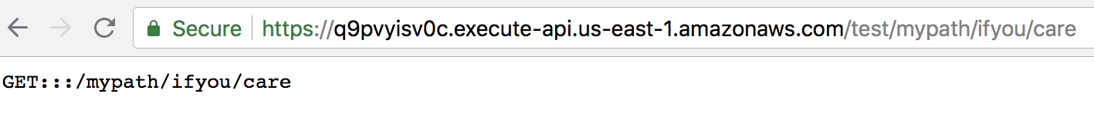
Executing the Lambda

Slide 48
Real Business Layer
We need the business layer to function “like” the native app (really wanted more than the word counts)
We need to leverage S3 for the document store
It has to process web requests
Would like to leverage cloud API features
Could have moved the C#
(using Node.js – exercise compare the code)

Slide 49
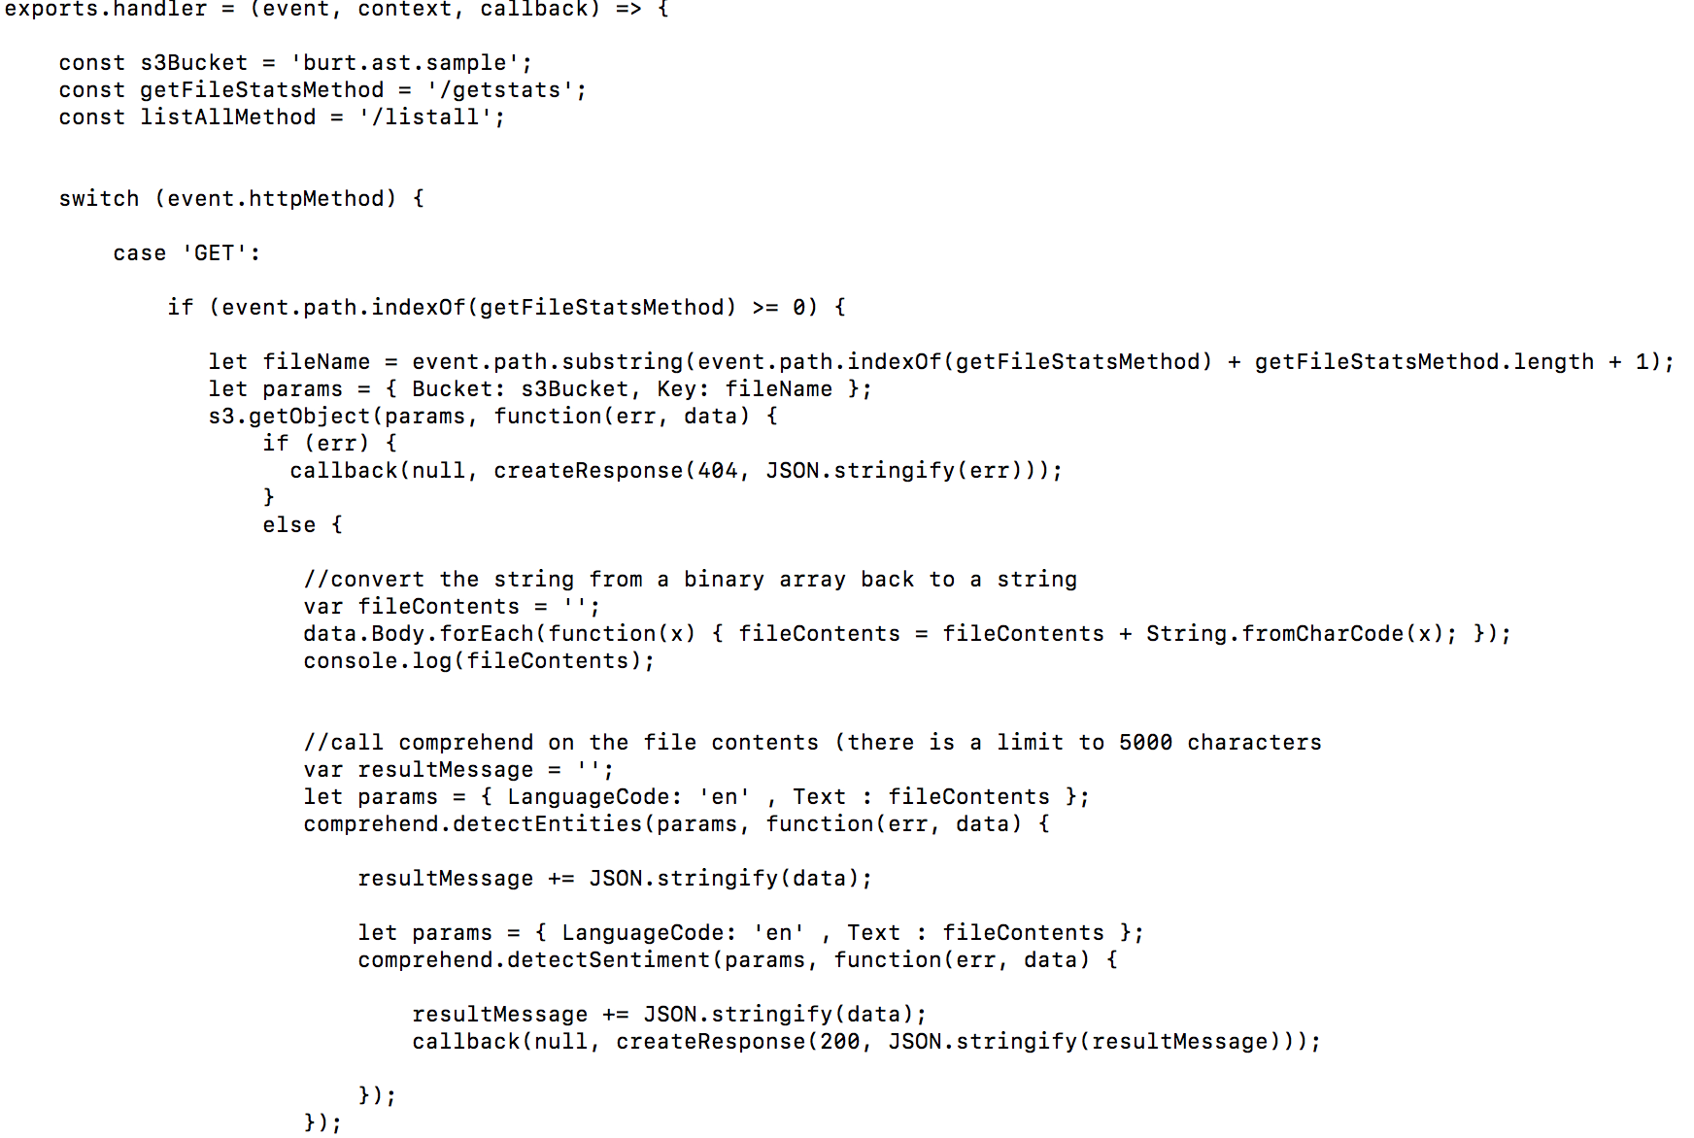

Slide 50
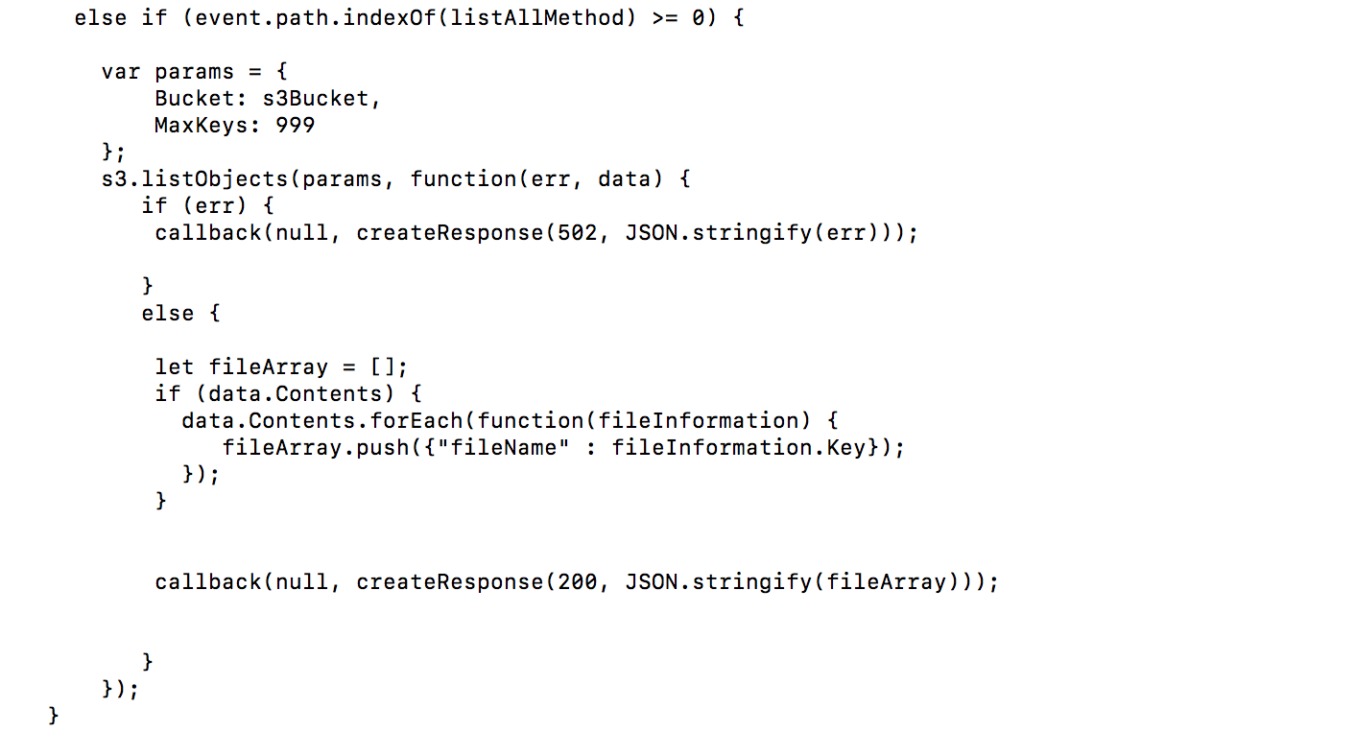

Slide 51
Permissions
The business layer needs to be able to access S3
The business layer needs to be able to use Comprehend
(AWS service for natural language processing & text analytics)
The business layer lambda needs to be given the right to assume the role which houses the S3 permissions and comprehend permissions

Slide 52
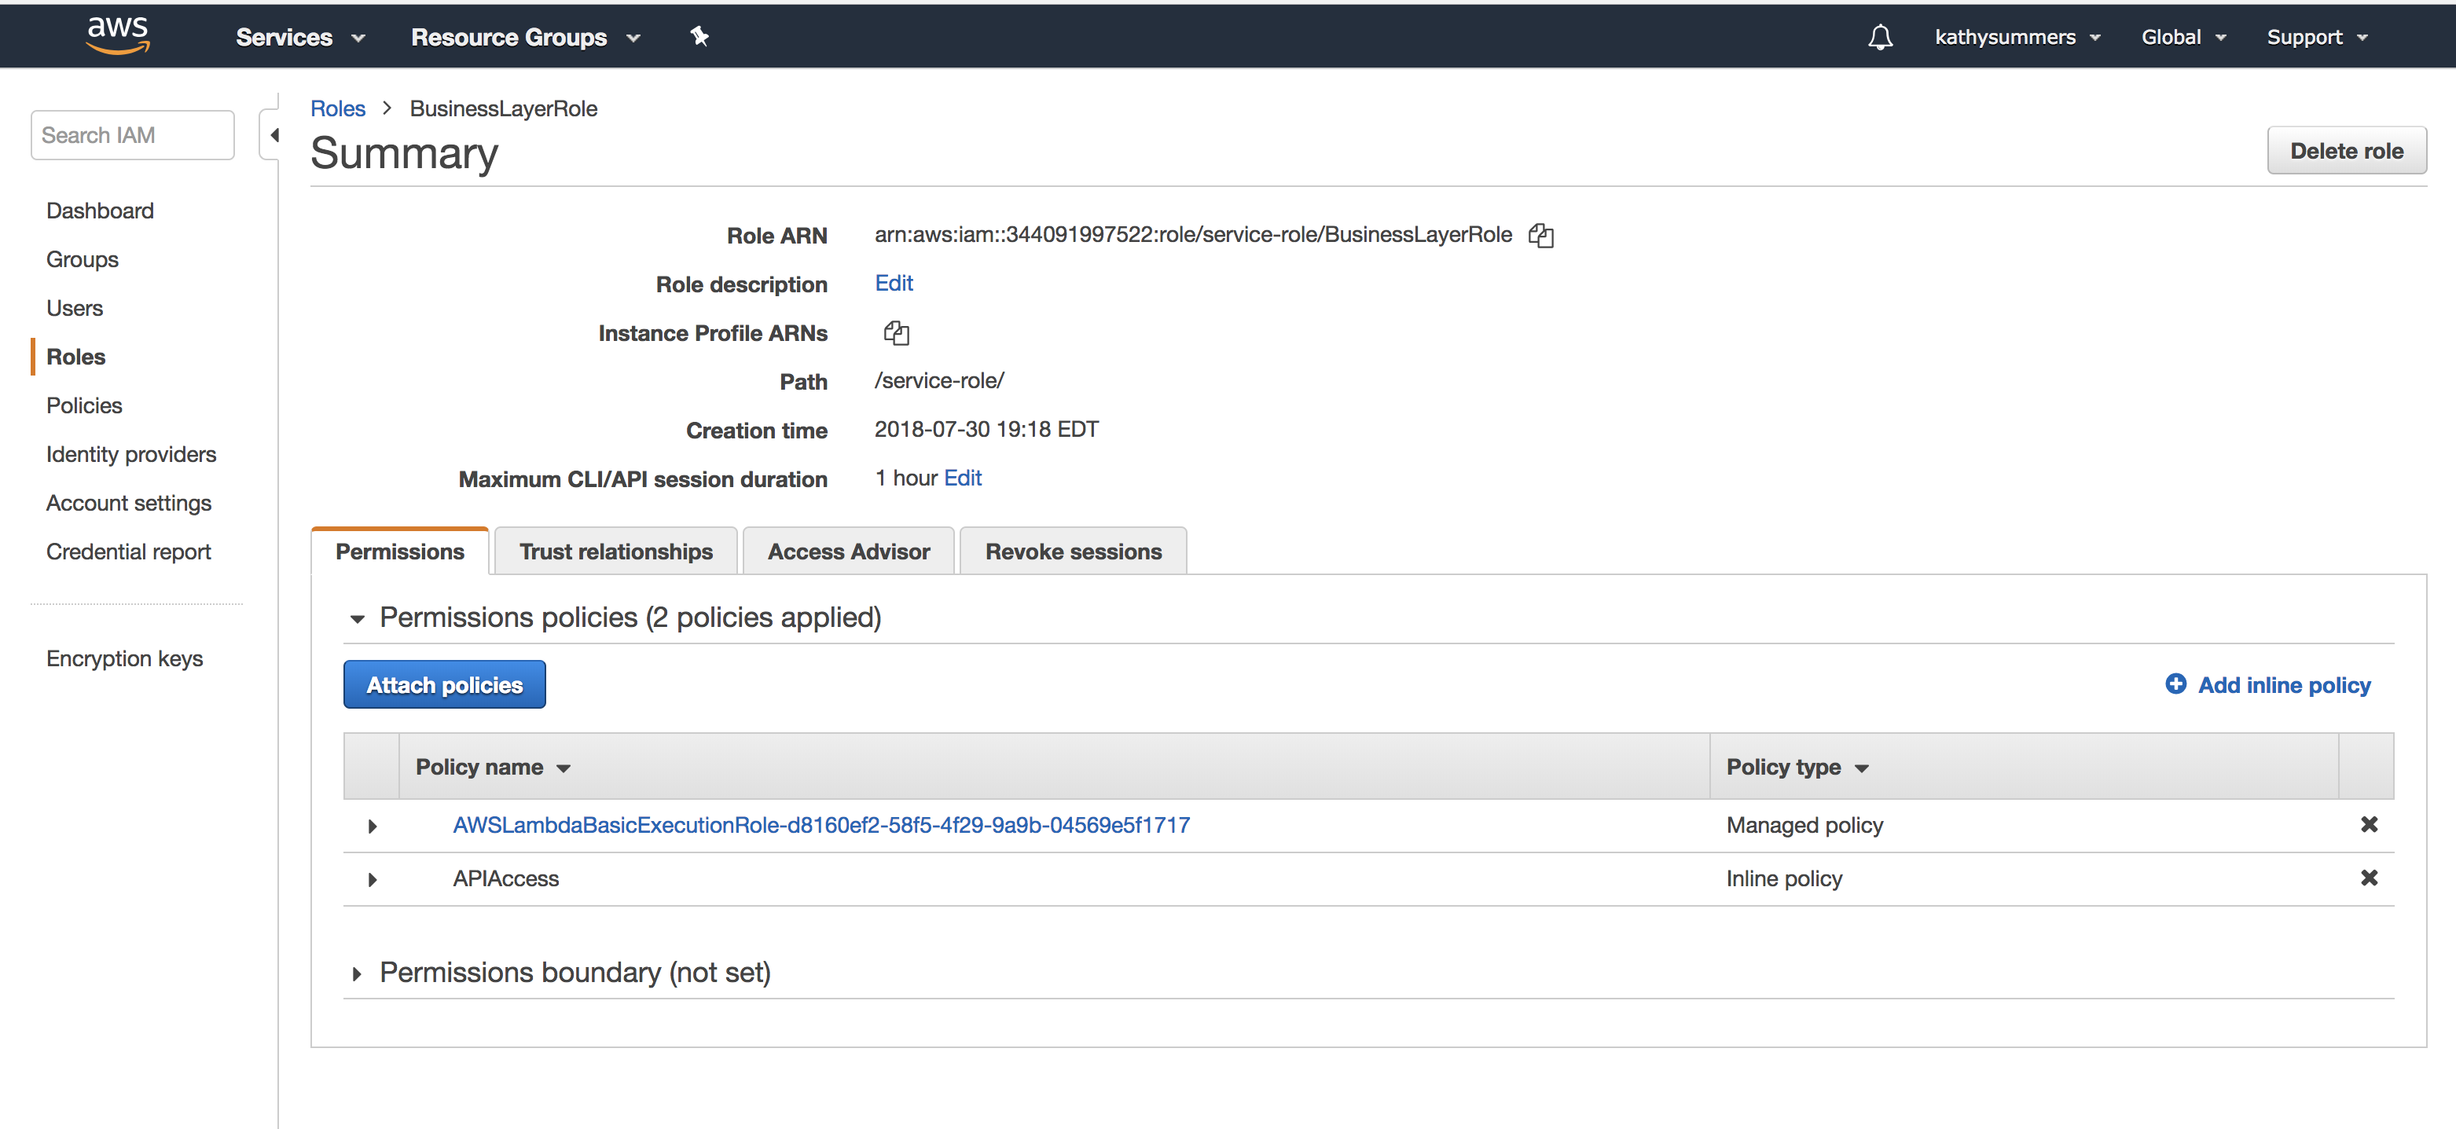
Permissions

Slide 53
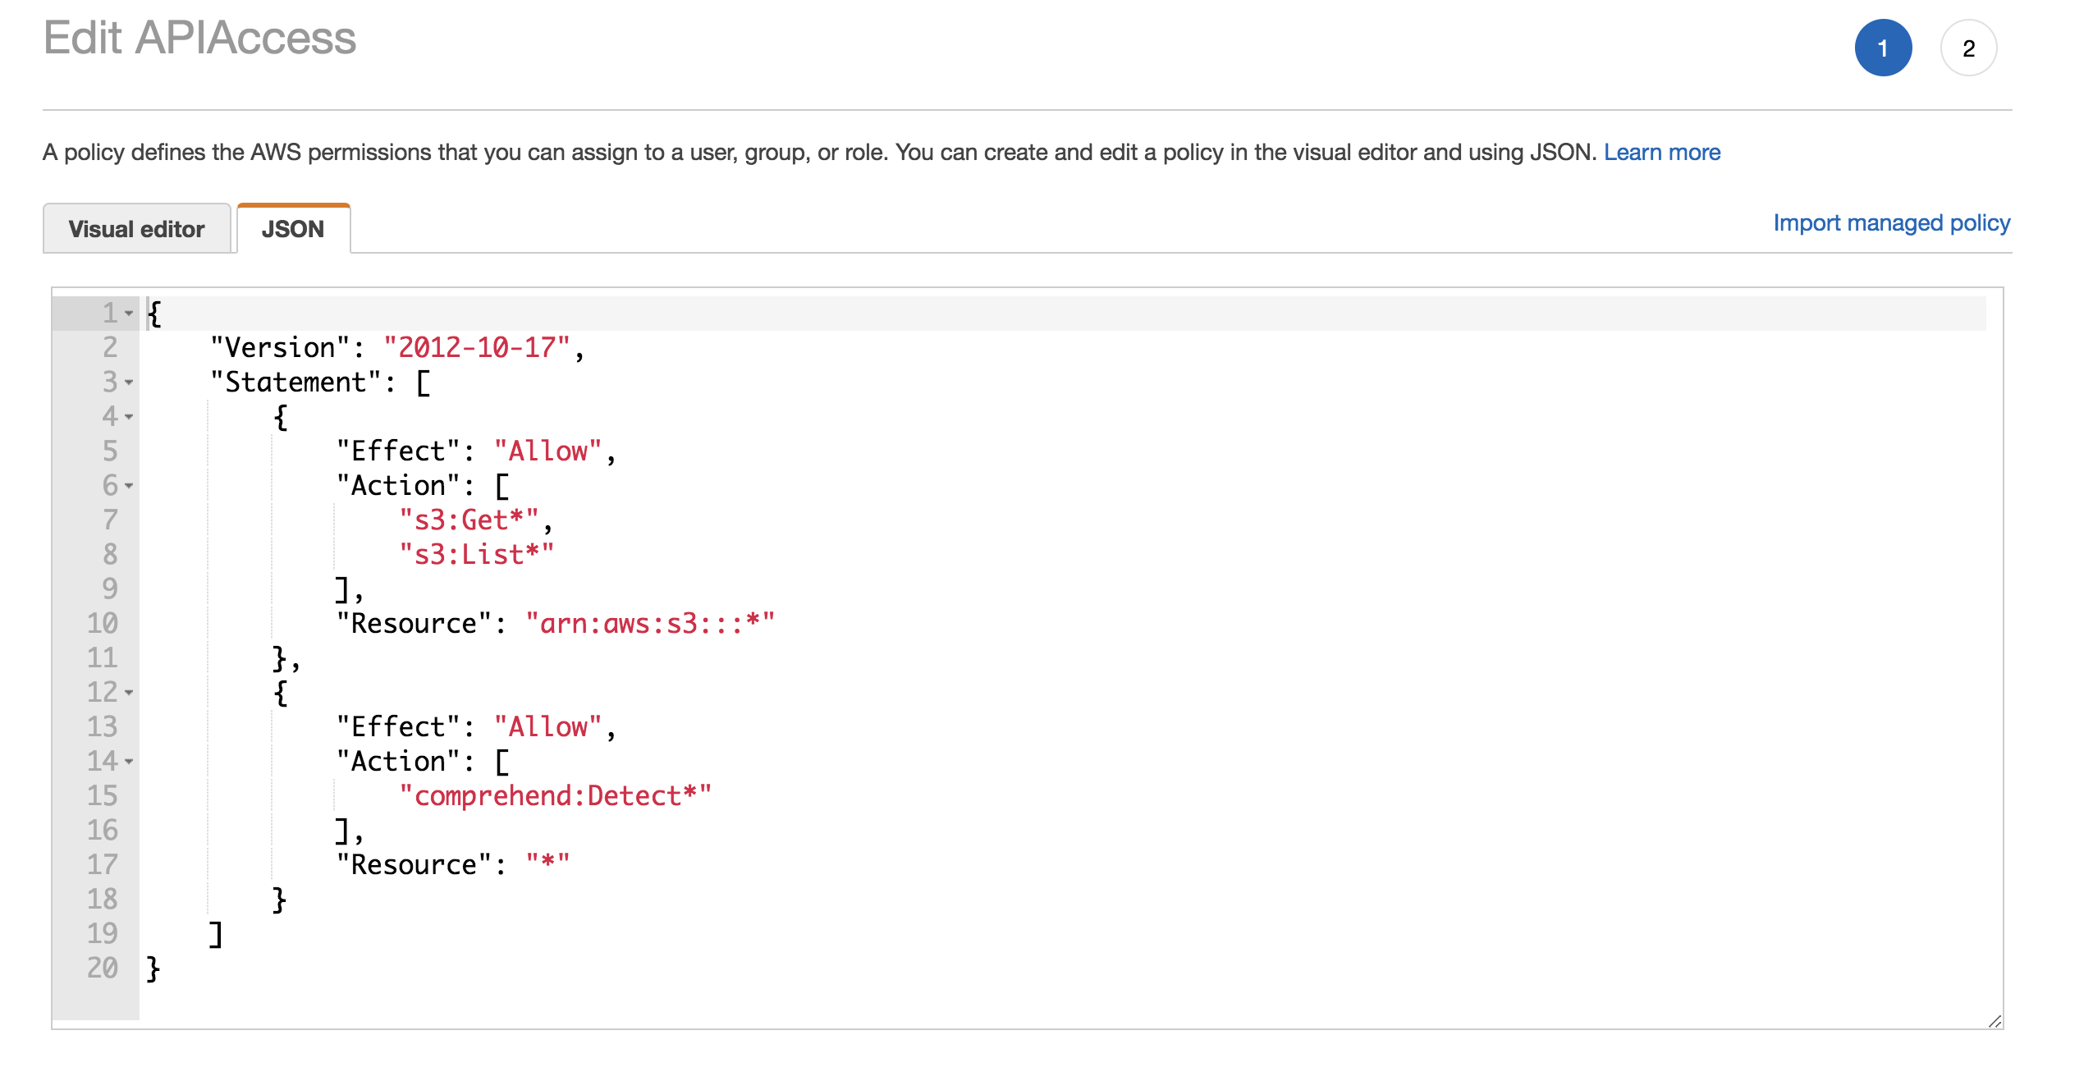
Permissions (continued)

Slide 54
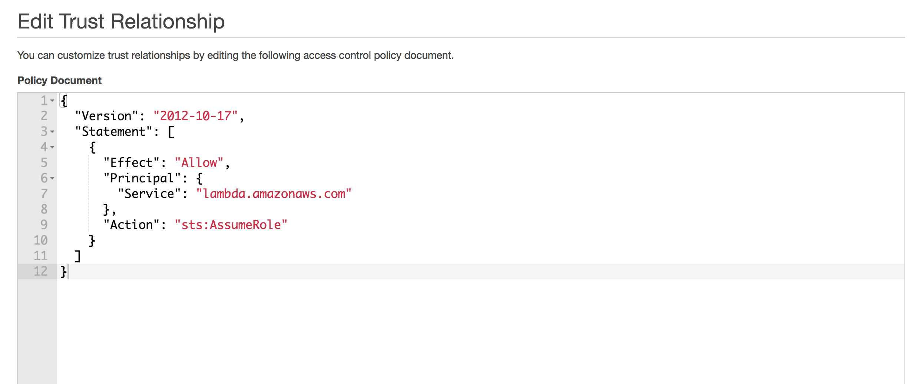
Permissions (continued)

Slide 55
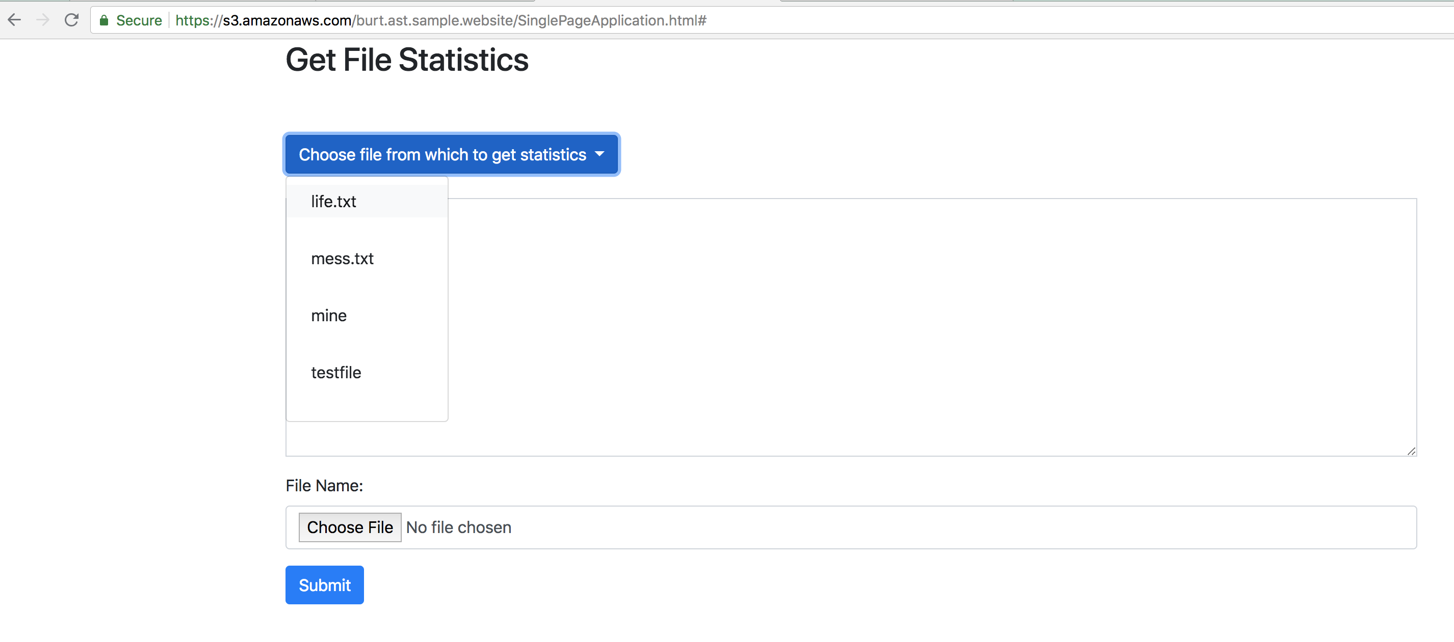
Selecting a File

Slide 56
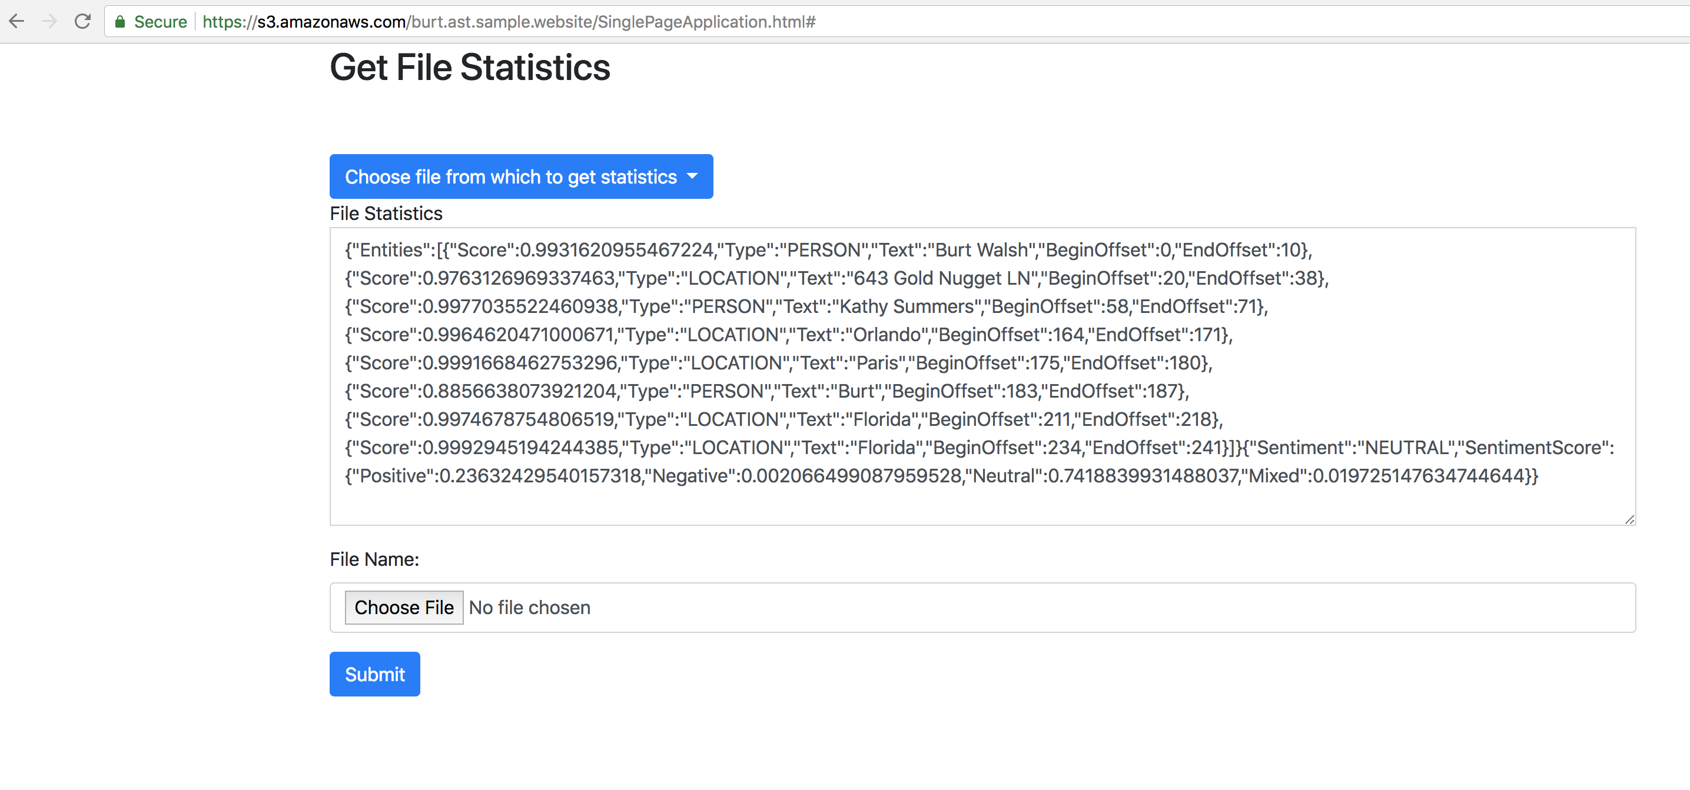
Getting Statistics

Slide 57
References
https://developers.google.com/web/progressive-web-apps/
https://docs.microsoft.com/en-us/aspnet/web-api/overview/getting-started-with-aspnet-web-api/tutorial-your-first-web-api
https://docs.microsoft.com/en-us/azure/azure-functions/
https://docs.aws.amazon.com/lambda/latest/dg/getting-started.html
https://nodejs.org/en/
https://msdn.microsoft.com/en-us/magazine/dn463786.aspx

Slide 58
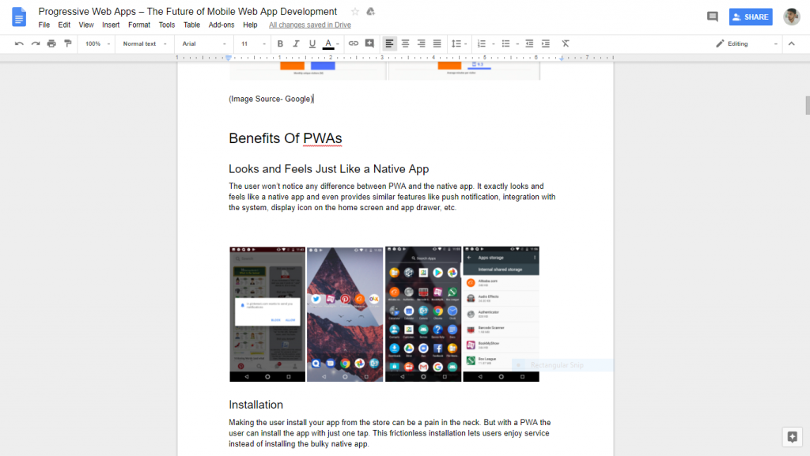
Single Page Application: Popular Example

Slide 59

Questions?
Burt Walsh
burt.walsh@ast.myflorida.com
Michael Avello
michael.avello@ast.myflorida.com
Agency For State Technology
4050 Esplanade Way, Suite 115
Tallahassee, Florida 32399

